Slide 1
Artefact to Art
Art and artists in the ancient world
Session 1: Making Art in Classical Athens

Slide 2
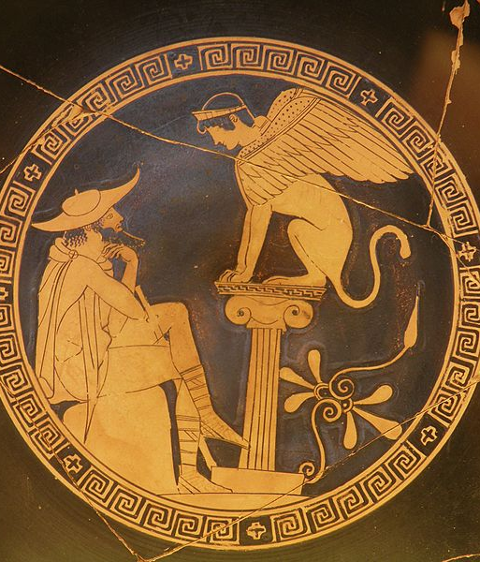
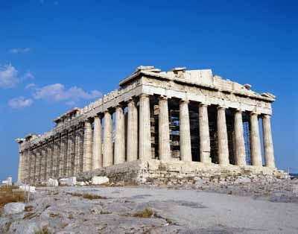
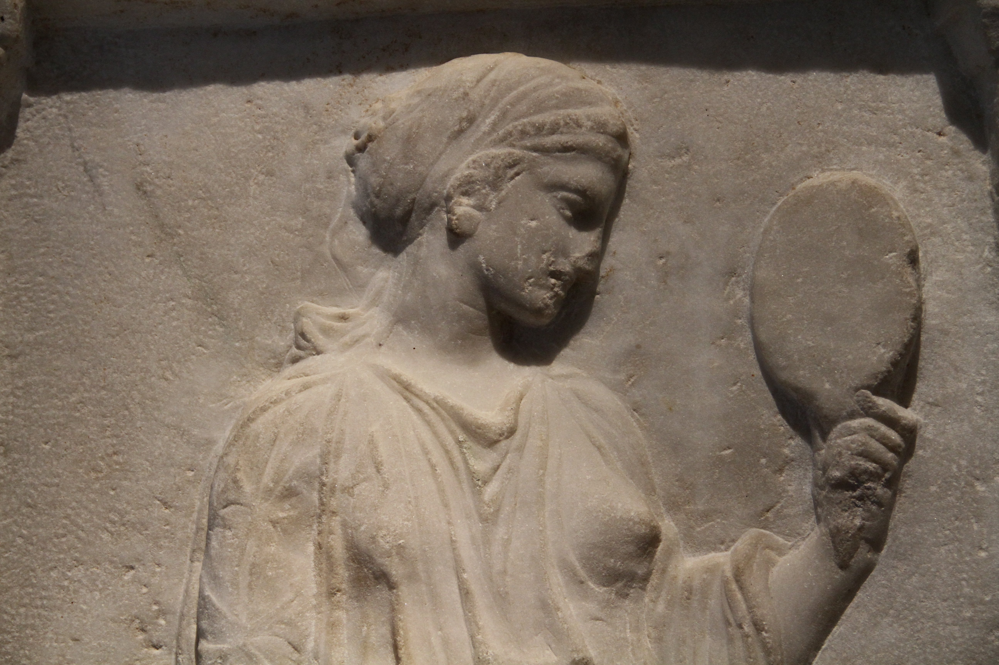
What is art?

Slide 3
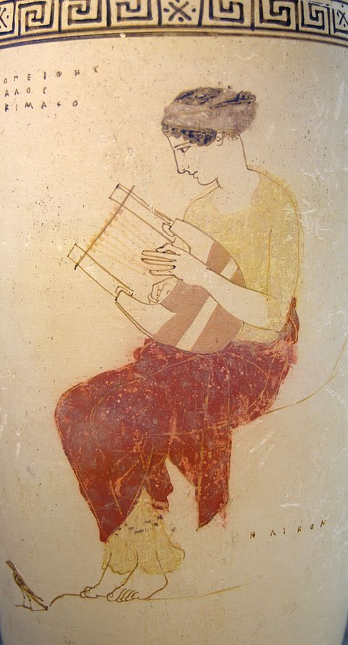
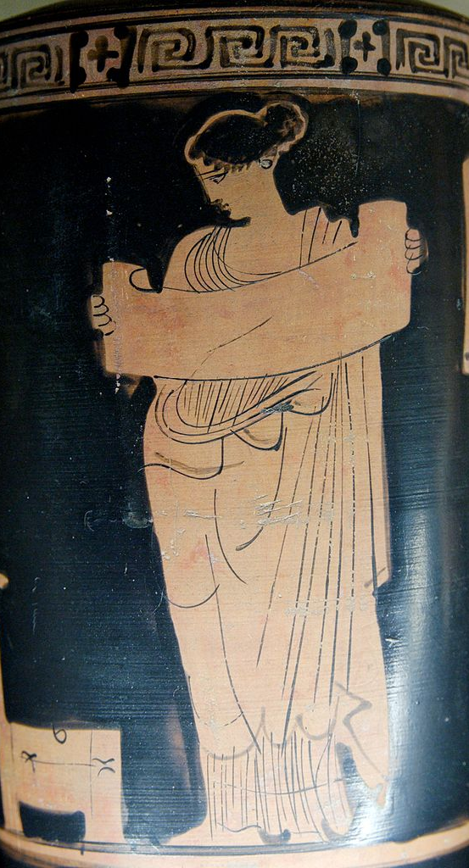
The Muses:
Calliope
Clio
Erato
Euterpe
Melpomene
Polyhymnia
Terpsichore
Thalia
Urania

