Slide 1
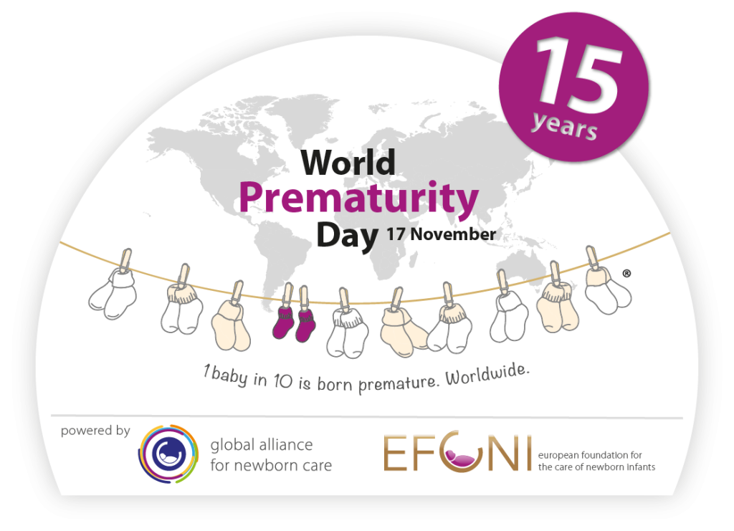
Welcome
Born just a few weeks early: Does it matter?

Slide 2
Programme
16.30 – 17.00 | Arrival and Refreshments
17.00 – 17.05 | Welcome and Introduction | Elizabeth Draper, Head of Department of Population Health Sciences
17.05 – 17.15 | Early birth and health challenges in Leicester | Elaine Boyle, LCFC Professor of Child Health
17.15 – 17.25 | Parents’ perspectives | Nafeesah Tutla, Leicester Mammas and LLR Maternity & Neonatal Voices Partnership
17.25 – 17.55 | Should our baby be born early? What say do we have? | Frances Mielewczyk, Researcher, LCFC Research Programme
 | Who supports breastfeeding for babies born a few weeks early? | Vimbai Mamombe, PhD Student and Research Assistant
 | How you feed your baby who arrives a little early – does it affect how they grow and develop? | Alice Kavati, Advanced Neonatal Nurse Practitioner and PhD student
 | How do mum’s health and baby’s early life experiences impact immunity? | Will Dodwell, Paediatrician in Training and PhD Student
17.55 – 18.00 | Close
18.00 | Drinks and refreshments
We are delighted to welcome representatives from ADAPT, Leicester Mammas and the Leicester, Leicestershire and Rutland Maternity and Neonatal Voices Partnership

Slide 3
Early birth and health challenges in Leicester
Elaine M Boyle

Slide 4
What is the LCFC Programme of Research?
Large donation to the University of Leicester
High quality research to improve the health of this and future generations of Leicester’s children
Studies exploring how early life experiences affect long-term health
Developing future leaders in Child Health Research in Leicester

Slide 5
Leicester compared with England as a whole
Teenage pregnancy
Smoking
Suboptimal BMI
Obesity in pregnancy
Stillbirth
Premature birth
Low birth weight
Deaths in the first month
Deaths in first year
Low vaccination rates
Child deaths
Childhood obesity
Dental decay
ED attendances
School readiness
Low income families
Reduced life expectancy

Slide 6
What influences child health?
Child poverty
Social deprivation
Ethnic mix
MOTHER
BABY
CHILDREN & FAMILIES
Antenatal care
Multiple birth
Pregnancy complications
Premature labour
Mode of delivery
Infant feeding choice
Low birth weight
Prematurity
Neonatal illness
Perinatal & infant mortality
Early feeding
Growth
CHILD
Health care inequalities

Slide 7
What influences child health?
Child poverty
Social deprivation
Ethnic mix
p
MATERNAL WELLBEING
Teenage pregnancy
Support networks
MOTHER
BABY
CHILDREN & FAMILIES
Antenatal care
Multiple birth
Pregnancy complications
Premature labour
Mode of delivery
Infant feeding choice
Low birth weight
Prematurity
Neonatal illness
Perinatal & infant mortality
Early feeding
Growth
Diet
Drugs
Alcohol
CHILD
BMI
Education
Smoking
Physical and mental health
Health care inequalities

Slide 8
What influences child health in Leicester?
LEICESTER
p
MATERNAL WELLBEING
Teenage pregnancy
Support networks
MOTHER
BABY
CHILDREN & FAMILIES
Antenatal care
Multiple birth
Pregnancy complications
Premature labour
Mode of delivery
Infant feeding choice
Low birth weight
Prematurity
Neonatal illness
Perinatal & infant mortality
Early feeding
Growth
Diet
Drugs
Alcohol
BMI
Education
Smoking
Physical and mental health

Slide 9
What influences child health in Leicester?
LEICESTER
Child poverty
Social deprivation
Ethnic mix
p
MATERNAL WELLBEING
Teenage pregnancy
Support networks
MOTHER
BABY
CHILDREN & FAMILIES
Antenatal care
Multiple birth
Pregnancy complications
Premature labour
Mode of delivery
Infant feeding choice
Low birth weight
Prematurity
Neonatal illness
Perinatal & infant mortality
Early feeding
Growth
Diet
Drugs
Alcohol
CHILD
BMI
Education
Smoking
Physical and mental health
Health care inequalities

Slide 10
What influences child health in Leicester?
LEICESTER
Child poverty
Social deprivation
Ethnic mix
p
MATERNAL WELLBEING
Teenage pregnancy
Support networks
MOTHER
BABY
CHILDREN & FAMILIES
Antenatal care
Multiple birth
Pregnancy complications
Premature labour
Mode of delivery
Infant feeding choice
Low birth weight
Prematurity
Neonatal illness
Perinatal & infant mortality
Early feeding
Growth
Diet
Drugs
Alcohol
CHILD
BMI
Education
Smoking
Physical and mental health
Health care inequalities

Slide 11
What influences child health in Leicester?
LEICESTER
Child poverty
Social deprivation
Ethnic mix
p
MATERNAL WELLBEING
Teenage pregnancy
Support networks
MOTHER
BABY
CHILDREN & FAMILIES
Antenatal care
Multiple birth
Pregnancy complications
Premature labour
Mode of delivery
Infant feeding choice
Low birth weight
Prematurity
Neonatal illness
Perinatal & infant mortality
Early feeding
Growth
Diet
Drugs
Alcohol
Overweight / obesity
Dental caries
Early years ED attendances
BMI
CHILD
Education
Smoking
Physical and mental health
Health care inequalities

Slide 12
Born just a few weeks early: does it matter?
23 24 25 26 27 28 29 30 31 32 33 34 35 36 37 38 39 40 41 42

Slide 13
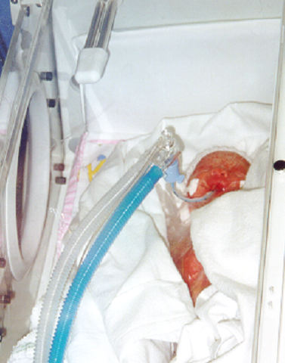
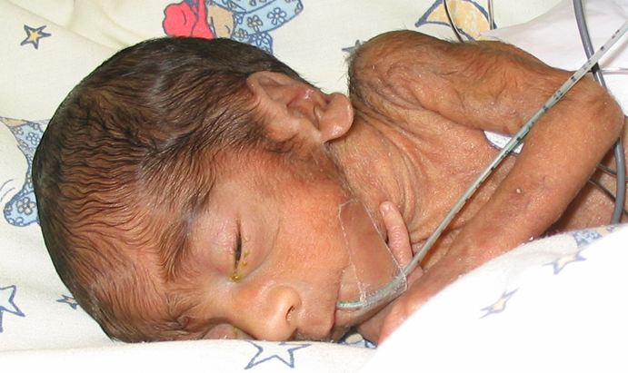
Born just a few weeks early: does it matter?
23 24 25 26 27 28 29 30 31 32 33 34 35 36 37 38 39 40 41 42

Slide 14
Born just a few weeks early: does it matter?
23 24 25 26 27 28 29 30 31 32 33 34 35 36 37 38 39 40 41 42
UK: approx. 2000 per year
Leicester: approx. 150 per year

Slide 15
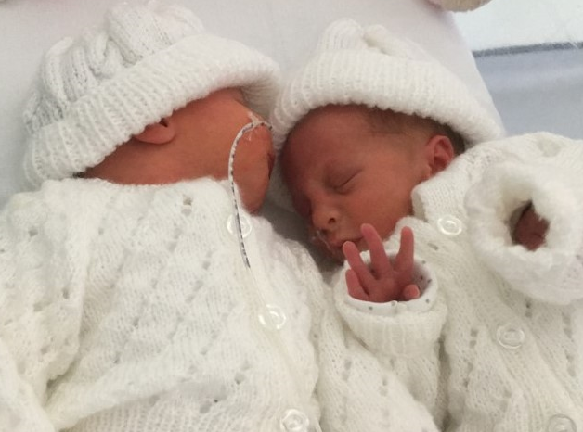
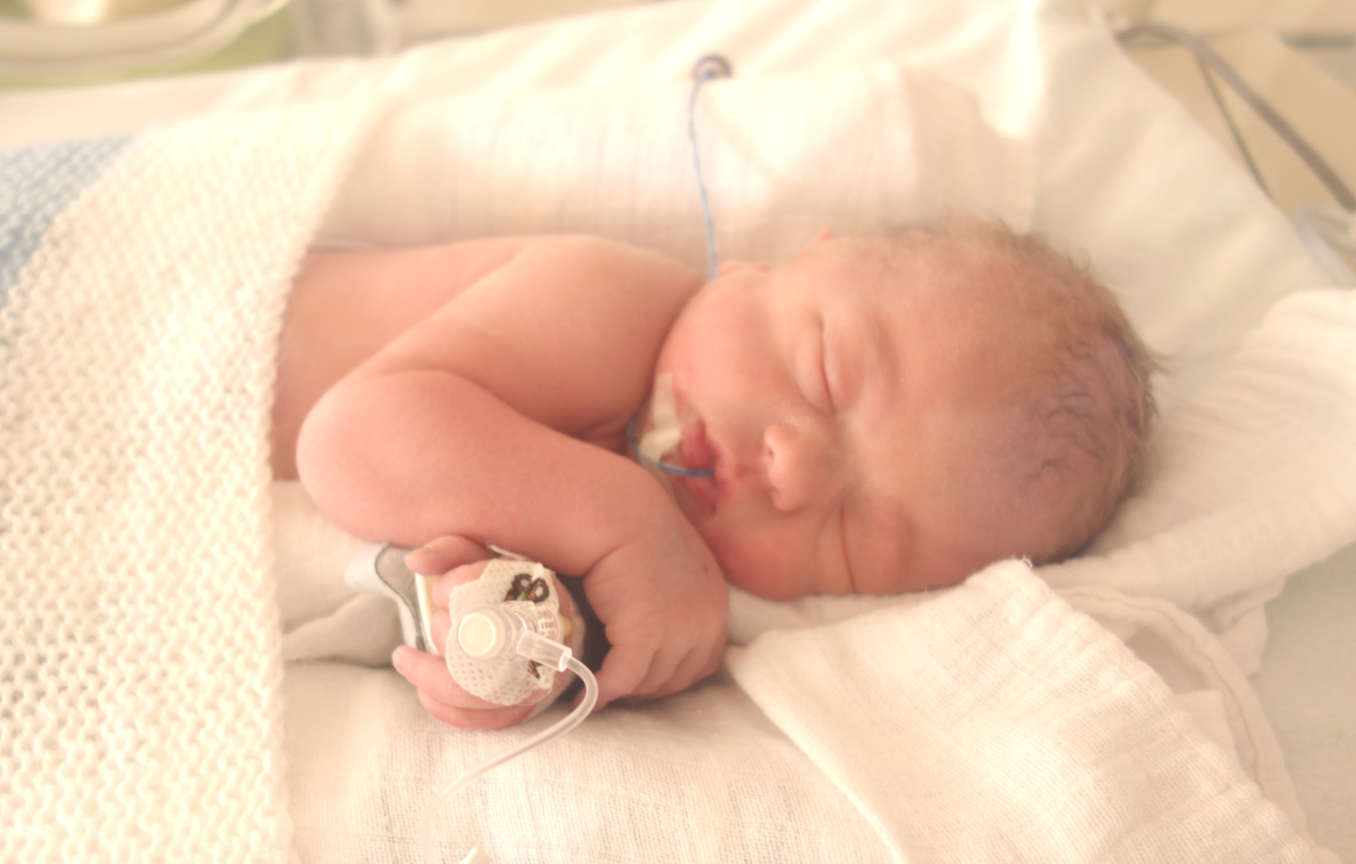
Born just a few weeks early: does it matter?
23 24 25 26 27 28 29 30 31 32 33 34 35 36 37 38 39 40 41 42
UK: approx. 2000 per year
Leicester: approx. 150 per year

Slide 16
Born just a few weeks early: does it matter?
23 24 25 26 27 28 29 30 31 32 33 34 35 36 37 38 39 40 41 42
UK: approx. 2000 per year
Leicester: approx. 150 per year
UK: approx. 200,000 per year
Leicester: approx. 3000 per year

Slide 17
Late preterm and early term babies
We know
More likely to have problems during newborn period, first months of life and childhood
Problems are less severe than for babies born more premature
We don’t know
Why some babies do better than others
Which babies are most likely to do worse
We want to find out
How can we identify those babies at risk of worse outcomes?
Many do not go on to have problems
How they should best be cared for and followed up
How can we improve outcomes for them?
Which factors (mum, baby, pregnancy, lifestyle) are important?
What is important for parents and families in Leicester?
Very large numbers

Slide 18
LCFC Research Programme
ED ATTENDANCES AND HOSPITAL ADMISSIONS
To explore the relationship between maternal and neonatal characteristics and early hospital care in the first year of life
LATE PRETERM AND EARLY TERM BIRTH COHORT STUDY
To collect high quality maternal, pregnancy, perinatal and neonatal data to inform the development of future research questions and provide a dataset for longitudinal research across the whole lifespan
Epidemiology
Fetus Neonate Infant Child Adolescent Adult Parent
PhD STUDY: NEONATAL BODY COMPOSITION
To study the relationship between maternal characteristics, neonatal characteristics and infant feeding choices and infant body composition
Clinical
PhD STUDY: HEALTH INEQUALITIES AND NEONATAL IMMUNOLOGY
To explore the influence of maternal and early life factors on neonatal immune function and epigenetics.
Basic science
Qualitative
PhD STUDY: BREASTFEEDING SUPPORT FOR LATE PRETERM INFANTS
To explore the role of healthcare professionals in provision of breastfeeding support
PARENTAL INVOLVEMENT IN DECISION-MAKING AROUND LATE PRETERM AND EARLY TERM DELIVERY
Public health
RAISING PARENT AND PUBLIC AWARENESS OF CHILD HEALTH CHALLENGES

Slide 19
LCFC Research Programme in Child Health
ED ATTENDANCES AND HOSPITAL ADMISSIONS
To explore the relationship between maternal and neonatal characteristics and early hospital care in the first year of life
LATE PRETERM AND EARLY TERM BIRTH COHORT STUDY
To collect high quality maternal, pregnancy, perinatal and neonatal data to inform the development of future research questions and provide a dataset for longitudinal research across the whole lifespan
Epidemiology
Fetus Neonate Infant Child Adolescent Adult Parent
PhD STUDY: NEONATAL BODY COMPOSITION
To study the relationship between maternal characteristics, neonatal characteristics and infant feeding choices and infant body composition
Clinical
PhD STUDY: HEALTH INEQUALITIES AND NEONATAL IMMUNOLOGY
To explore the influence of maternal and early life factors on neonatal immune function and epigenetics.
Basic science
Qualitative
PhD STUDY: BREASTFEEDING SUPPORT FOR LATE PRETERM INFANTS
To explore the role of healthcare professionals in provision of breastfeeding support
PARENTAL INVOLVEMENT IN DECISION-MAKING AROUND LATE PRETERM AND EARLY TERM DELIVERY
Public health
RAISING PARENT AND PUBLIC AWARENESS OF CHILD HEALTH CHALLENGES

Slide 20
LCFC Research Programme in Child Health
ED ATTENDANCES AND HOSPITAL ADMISSIONS
To explore the relationship between maternal and neonatal characteristics and early hospital care in the first year of life
LATE PRETERM AND EARLY TERM BIRTH COHORT STUDY
To collect high quality maternal, pregnancy, perinatal and neonatal data to inform the development of future research questions and provide a dataset for longitudinal research across the whole lifespan
Epidemiology
Fetus Neonate Infant Child Adolescent Adult Parent
PhD STUDY: NEONATAL BODY COMPOSITION
To study the relationship between maternal characteristics, neonatal characteristics and infant feeding choices and infant body composition
GROWTH AND DEVELOPMENT
Clinical
RESPIRATORY HEALTH
CARDIOVASCULAR HEALTH
PhD STUDY: HEALTH INEQUALITIES AND NEONATAL IMMUNOLOGY
To explore the influence of maternal and early life factors on neonatal immune function and epigenetics.
Basic science
Qualitative
PhD STUDY: BREASTFEEDING SUPPORT FOR LATE PRETERM INFANTS
To explore the role of healthcare professionals in provision of breastfeeding support
PARENTAL INVOLVEMENT IN DECISION-MAKING AROUND LATE PRETERM AND EARLY TERM DELIVERY
Public health
RAISING PARENT AND PUBLIC AWARENESS OF CHILD HEALTH CHALLENGES

Slide 21
Programme
16.30 – 17.00 | Arrival and Refreshments
17.00 – 17.05 | Welcome and Introduction | Elizabeth Draper, Head of Department of Population Health Sciences
17.05 – 17.15 | Early birth and health challenges in Leicester | Elaine Boyle, LCFC Professor of Child Health
17.15 – 17.25 | Parents’ perspectives | Nafeesah Tutla, Leicester Mammas and LLR Maternity & Neonatal Voices Partnership
17.25 – 17.55 | Should our baby be born early? What say do we have? | Frances Mielewczyk, Researcher, LCFC Research Programme
 | Who supports breastfeeding for babies born a few weeks early? | Vimbai Mamombe, PhD Student and Research Assistant
 | How you feed your baby who arrives a little early – does it affect how they grow and develop? | Alice Kavati, Advanced Neonatal Nurse Practitioner and PhD student
 | How do mum’s health and baby’s early life experiences impact immunity? | Will Dodwell, Paediatrician in Training and PhD Student
17.55 – 18.00 | Close
18.00 | Please join us for drinks and refreshments
We are delighted to welcome representatives from ADAPT, Leicester Mammas and the Leicester, Leicestershire and Rutland Maternity and Neonatal Voices Partnership

Slide 22
Should our baby be born early?
What say do we have?
Frances J Mielewczyk

Slide 23
Why are babies born 2-6 weeks early?
Over 200,000 babies are born 2-6 weeks early in England & Wales each year.
This often happens without warning but for others the birth is planned in advance due to problems with the pregnancy.
In these cases, early birth has been judged to be less risky than carrying on with the pregnancy.

Slide 24
How is the decision made?
Obstetrician
responsible for the final decision
Parents
how much say
do/should they have?
Midwife
involved in discussions

Slide 25
What do parents want?
Mothers and fathers want to be involved in decision-making
Up to half of women are dissatisfied with their involvement
Some of those become dissatisfied with their maternity care as a whole

Slide 26
What do we need to know?
Parents
What input do they want and expect?
What input do they have?
Obstetricians & Midwives
What do they think parents want and expect?
What input do they think parents can and should have?

Slide 27
How will we try to find out?
Ask!
Obstetricians responsible for decisions about early birth
Parents whose babies were considered for early birth
Midwives involved in discussions about early birth

Slide 28
What do we hope to achieve?
Find out what parents, midwives and obstetricians think and have experienced about parents’ input into decisions.
Explore the similarities and differences between the three groups.
Use what we find out to:
a) suggest ways in which parents can be better supported in future
b) suggest where more research may be needed

Slide 29
Would you like to take part?
Parents
Please get in touch:
fjm13@le.ac.uk
(0116) 252 5468
Obstetricians
Midwives
Thank you ☺

Slide 30
Programme
16.30 – 17.00 | Arrival and Refreshments
17.00 – 17.05 | Welcome and Introduction | Elizabeth Draper, Head of Department of Population Health Sciences
17.05 – 17.15 | Early birth and health challenges in Leicester | Elaine Boyle, LCFC Professor of Child Health
17.15 – 17.25 | Parents’ perspectives | Nafeesah Tutla, Leicester Mammas and LLR Maternity & Neonatal Voices Partnership
17.25 – 17.55 | Should our baby be born early? What say do we have? | Frances Mielewczyk, Researcher, LCFC Research Programme
 | Who supports breastfeeding for babies born a few weeks early? | Vimbai Mamombe, PhD Student and Research Assistant
 | How you feed your baby who arrives a little early – does it affect how they grow and develop? | Alice Kavati, Advanced Neonatal Nurse Practitioner and PhD student
 | How do mum’s health and baby’s early life experiences impact immunity? | Will Dodwell, Paediatrician in Training and PhD Student
17.55 – 18.00 | Close
18.00 | Please join us for drinks and refreshments
We are delighted to welcome representatives from ADAPT, Leicester Mammas and the Leicester, Leicestershire and Rutland Maternity and Neonatal Voices Partnership

Slide 31
Who supports breastfeeding for babies born a few weeks early?
Vimbai L Mamombe

Slide 32
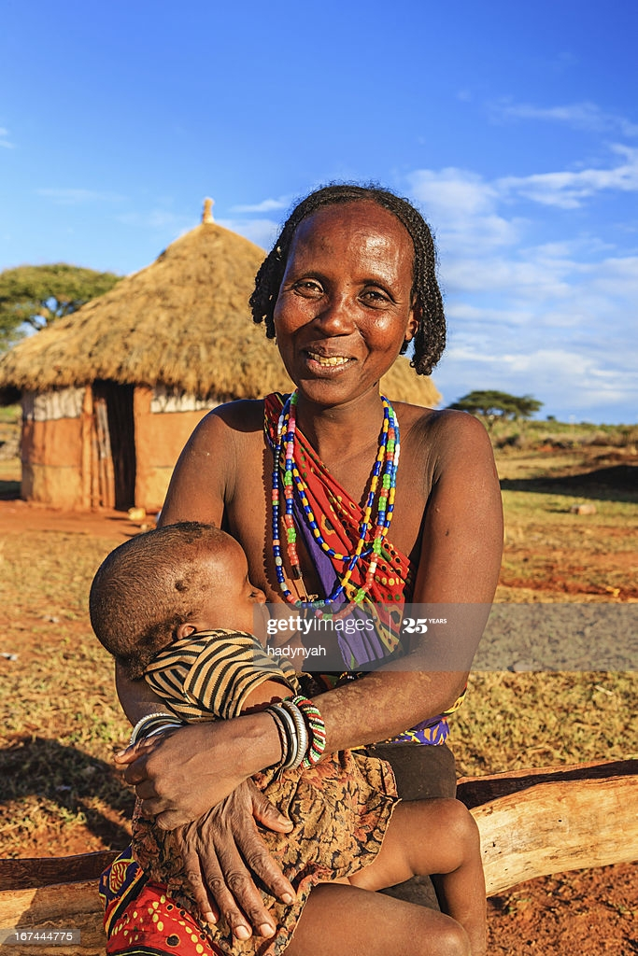
Why this subject?
Psychology of health and eating
Role of infant feeding in later obesity
Why do mothers choose not to breastfeed?
Mothers’ experiences of breastfeeding support
Late preterm babies less likely to breastfeed successfully

Slide 33
Breastfeeding is regarded as the best source of nutrition for babies
Nutritionally complete
Boosts the immune system
Benefits long term health
Benefits for mother
Societal benefits

Slide 34
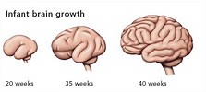
About the Late preterm babies
Often a good weight and size at birth
Immaturities are not always obvious
Immature suck-swallow-breathe
Immature nervous system
Less likely to breastfeed successfully
“Breastfeeding” for this research refers to the feeding of late preterm babies with mother’s own milk during initial hospital stay after birth

Slide 35
Late preterm compared to term births
Mums
More likely to be
Babies
More likely to be
Younger
Born by caesarean section
From non-white ethnic groups
Admitted to a neonatal unit
From less affluent groups
In hospital for longer after birth

Slide 36
Who interacts with breastfeeding in a hospital setting?
Health Care Professionals
Mother
Policy
Family

Slide 37
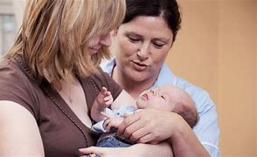
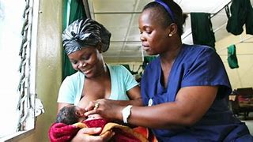
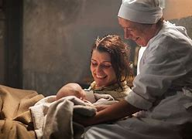
Health care professionals and care of late preterm babies
Who?
Midwives
Nursery nurses
Neonatal nurses
Healthcare assistants
Doctors (neonatologists, paediatricians, doctors in training)
Where?
Labour ward
Postnatal wards
Transitional care
Neonatal unit (Special Care, High Dependency, Intensive Care)

Slide 38
This study looks at what part health care professionals play in breastfeeding support for mothers and their late preterm babies?
How do they perceive their roles and how do roles vary?
How does breastfeeding support actually work in practice?
What affects the success of breastfeeding support?

Slide 39
Qualitative research project
National and local surveys
Surveys were sent out to healthcare professionals involved in the support late preterm babies, to provide broad context
Interviews
With a range of healthcare professionals in Leicester’s hospitals
Document analysis
National policies and frameworks
Local guidelines

Slide 40
10. Discussion
What might we learn?
Health care professionals may be key in helping mothers navigate challenges of immaturity during hospital stay
Description of breastfeeding support from the perspective of health care professionals may bring to light “unseen” roles
Better understanding of factors that influence successful breastfeeding may guide policy development

Slide 41
Thank You Ndatenda Siyabonga

Slide 42
Programme
16.30 – 17.00 | Arrival and Refreshments
17.00 – 17.05 | Welcome and Introduction | Elizabeth Draper, Head of Department of Population Health Sciences
17.05 – 17.15 | Early birth and health challenges in Leicester | Elaine Boyle, LCFC Professor of Child Health
17.15 – 17.25 | Parents’ perspectives | Nafeesah Tutla, Leicester Mammas and LLR Maternity & Neonatal Voices Partnership
17.25 – 17.55 | Should our baby be born early? What say do we have? | Frances Mielewczyk, Researcher, LCFC Research Programme
 | Who supports breastfeeding for babies born a few weeks early? | Vimbai Mamombe, PhD Student and Research Assistant
 | How you feed your baby who arrives a little early – does it affect how they grow and develop? | Alice Kavati, Advanced Neonatal Nurse Practitioner and PhD student
 | How do mum’s health and baby’s early life experiences impact immunity? | Will Dodwell, Paediatrician in Training and PhD Student
17.55 – 18.00 | Close
18.00 | Please join us for drinks and refreshments
We are delighted to welcome representatives from ADAPT, Leicester Mammas and the Leicester, Leicestershire and Rutland Maternity and Neonatal Voices Partnership

Slide 43
Your baby’s first milk
Does it affect how they grow?
Alice B Kavati

Slide 44
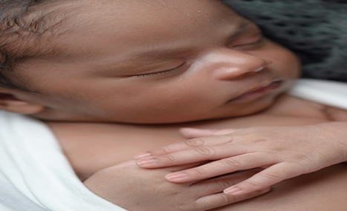
Are babies born a few weeks early different?
Babies born a few weeks early more commonly experience a difficult start to life
They are more at risk of health problems as newborns and infants compared to babies born on their due date
Untitled. Daisy Lapara, Pexels.
Creative Commons Public Domain

Slide 45
Early birth and risk of overweight in childhood
Babies born 4-6 weeks early might not grow as well in infancy and the quality of their growth may be different, we don’t really know
Higher risk of becoming overweight in childhood
Being overweight in childhood increases the risk of diseases such as diabetes

Slide 46
Does the type of milk affect the way a baby born early grows?
Birth
Term (40 weeks)
One month
Three months
Type of Feeding
Formula milk
Breastmilk
Mixed feeding
Growth Measurements
Head circumference
Length
Weight
Lean mass
Fat mass

Slide 47
Why is this important and what do I hope to find out
Certain patterns of early growth are linked to an increased risk overweight
Does the type of milk affect body composition and growth?
How well does this group of
babies
grow in Leicester?
Ethnicity, maternal health and infant body composition
Leicester Clock Tower. NotfromUtrech. Creative
Commons Attribution Share alike.

Slide 48
Thank you for listening
Would you like to find out more?
Please contact me:
abk9@leicester.ac.uk

Slide 49
Programme
16.30 – 17.00 | Arrival and Refreshments
17.00 – 17.05 | Welcome and Introduction | Elizabeth Draper, Head of Department of Population Health Sciences
17.05 – 17.15 | Early birth and health challenges in Leicester | Elaine Boyle, LCFC Professor of Child Health
17.15 – 17.25 | Parents’ perspectives | Nafeesah Tutla, Leicester Mammas and LLR Maternity & Neonatal Voices Partnership
17.25 – 17.55 | Should our baby be born early? What say do we have? | Frances Mielewczyk, Researcher, LCFC Research Programme
 | Who supports breastfeeding for babies born a few weeks early? | Vimbai Mamombe, PhD Student and Research Assistant
 | How you feed your baby who arrives a little early – does it affect how they grow and develop? | Alice Kavati, Advanced Neonatal Nurse Practitioner and PhD student
 | How do mum’s health and baby’s early life experiences impact immunity? | Will Dodwell, Paediatrician in Training and PhD Student
17.55 – 18.00 | Close
18.00 | Please join us for drinks and refreshments
We are delighted to welcome representatives from ADAPT, Leicester Mammas and the Leicester, Leicestershire and Rutland Maternity and Neonatal Voices Partnership

Slide 50
How do mum’s health and babies’ early life experiences affect immunity?
Will Dodwell

Slide 51
Infant Health Outcomes
Infant mortality in the United Kingdom is rising.
Social deprivation is a major determinant of health outcomes.
3/4 of infant deaths occur during the first 4 weeks of life.

Slide 53
Study Design
Cord blood sample
Heel prick sample
Immune cell isolation and analysis
Recruit 160-200 infants born between 34 and 42 weeks GA
Day 5 of life
Follow up at 2 years
Follow up at 5 years
Stool sample
Microbiome analysis

Slide 54
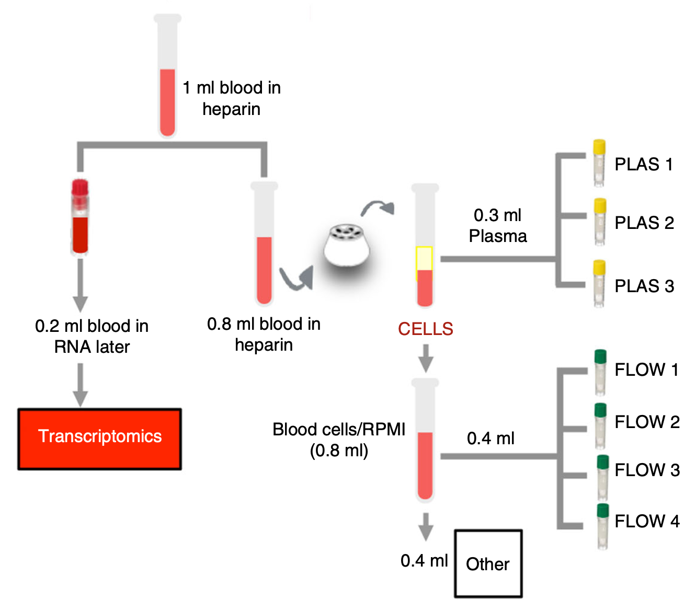
Analysis
1ml of blood
Plasma proteins
0.3ml
Plasma metabolites
0.1ml of blood for RNA seq
0.9ml blood
Gene regulation
0.6ml
DNA changes
Immune cell frequencies
Immune cell function

Slide 55
What do we aim to learn?
Explore how maternal and infant early life exposures affect the infant immune system.
Better understand the rapid development of infants’ immune system over the first week of life.
Explore the role of maternal and early life exposures on childhood health and disease.

Slide 56
Questions or Comments
Thank you for listening
???

Slide 57
Programme
16.30 – 17.00 | Arrival and Refreshments
17.00 – 17.05 | Welcome and Introduction | Elizabeth Draper, Head of Department of Population Health Sciences
17.05 – 17.15 | Early birth and health challenges in Leicester | Elaine Boyle, LCFC Professor of Child Health
17.15 – 17.25 | Parents’ perspectives | Nafeesah Tutla, Leicester Mammas and LLR Maternity & Neonatal Voices Partnership
17.25 – 17.55 | Should our baby be born early? What say do we have? | Frances Mielewczyk, Researcher, LCFC Research Programme
 | Who supports breastfeeding for babies born a few weeks early? | Vimbai Mamombe, PhD Student and Research Assistant
 | How you feed your baby who arrives a little early – does it affect how they grow and develop? | Alice Kavati, Advanced Neonatal Nurse Practitioner and PhD student
 | How do mum’s health and baby’s early life experiences impact immunity? | Will Dodwell, Paediatrician in Training and PhD Student
17.55 – 18.00 | Close
18.00 | Please join us for drinks and refreshments
We are delighted to welcome representatives from ADAPT, Leicester Mammas and the Leicester, Leicestershire and Rutland Maternity and Neonatal Voices Partnership

Slide 58
We need your help!
The best research is guided by the people for whom it is most relevant
We need to know if our research is important, understandable and acceptable to parents and families in Leicester
We are looking for parents and members of the public in Leicester to help us refine our research, review our study documents and help us make sure it will all work in practice
If you are interested and can spare a small amount of time to help us, please let me know NOW or BY EMAIL or BY PHONE
Elaine Boyle
eb124@leicester.ac.uk
0116 252 5447

