Slide 1
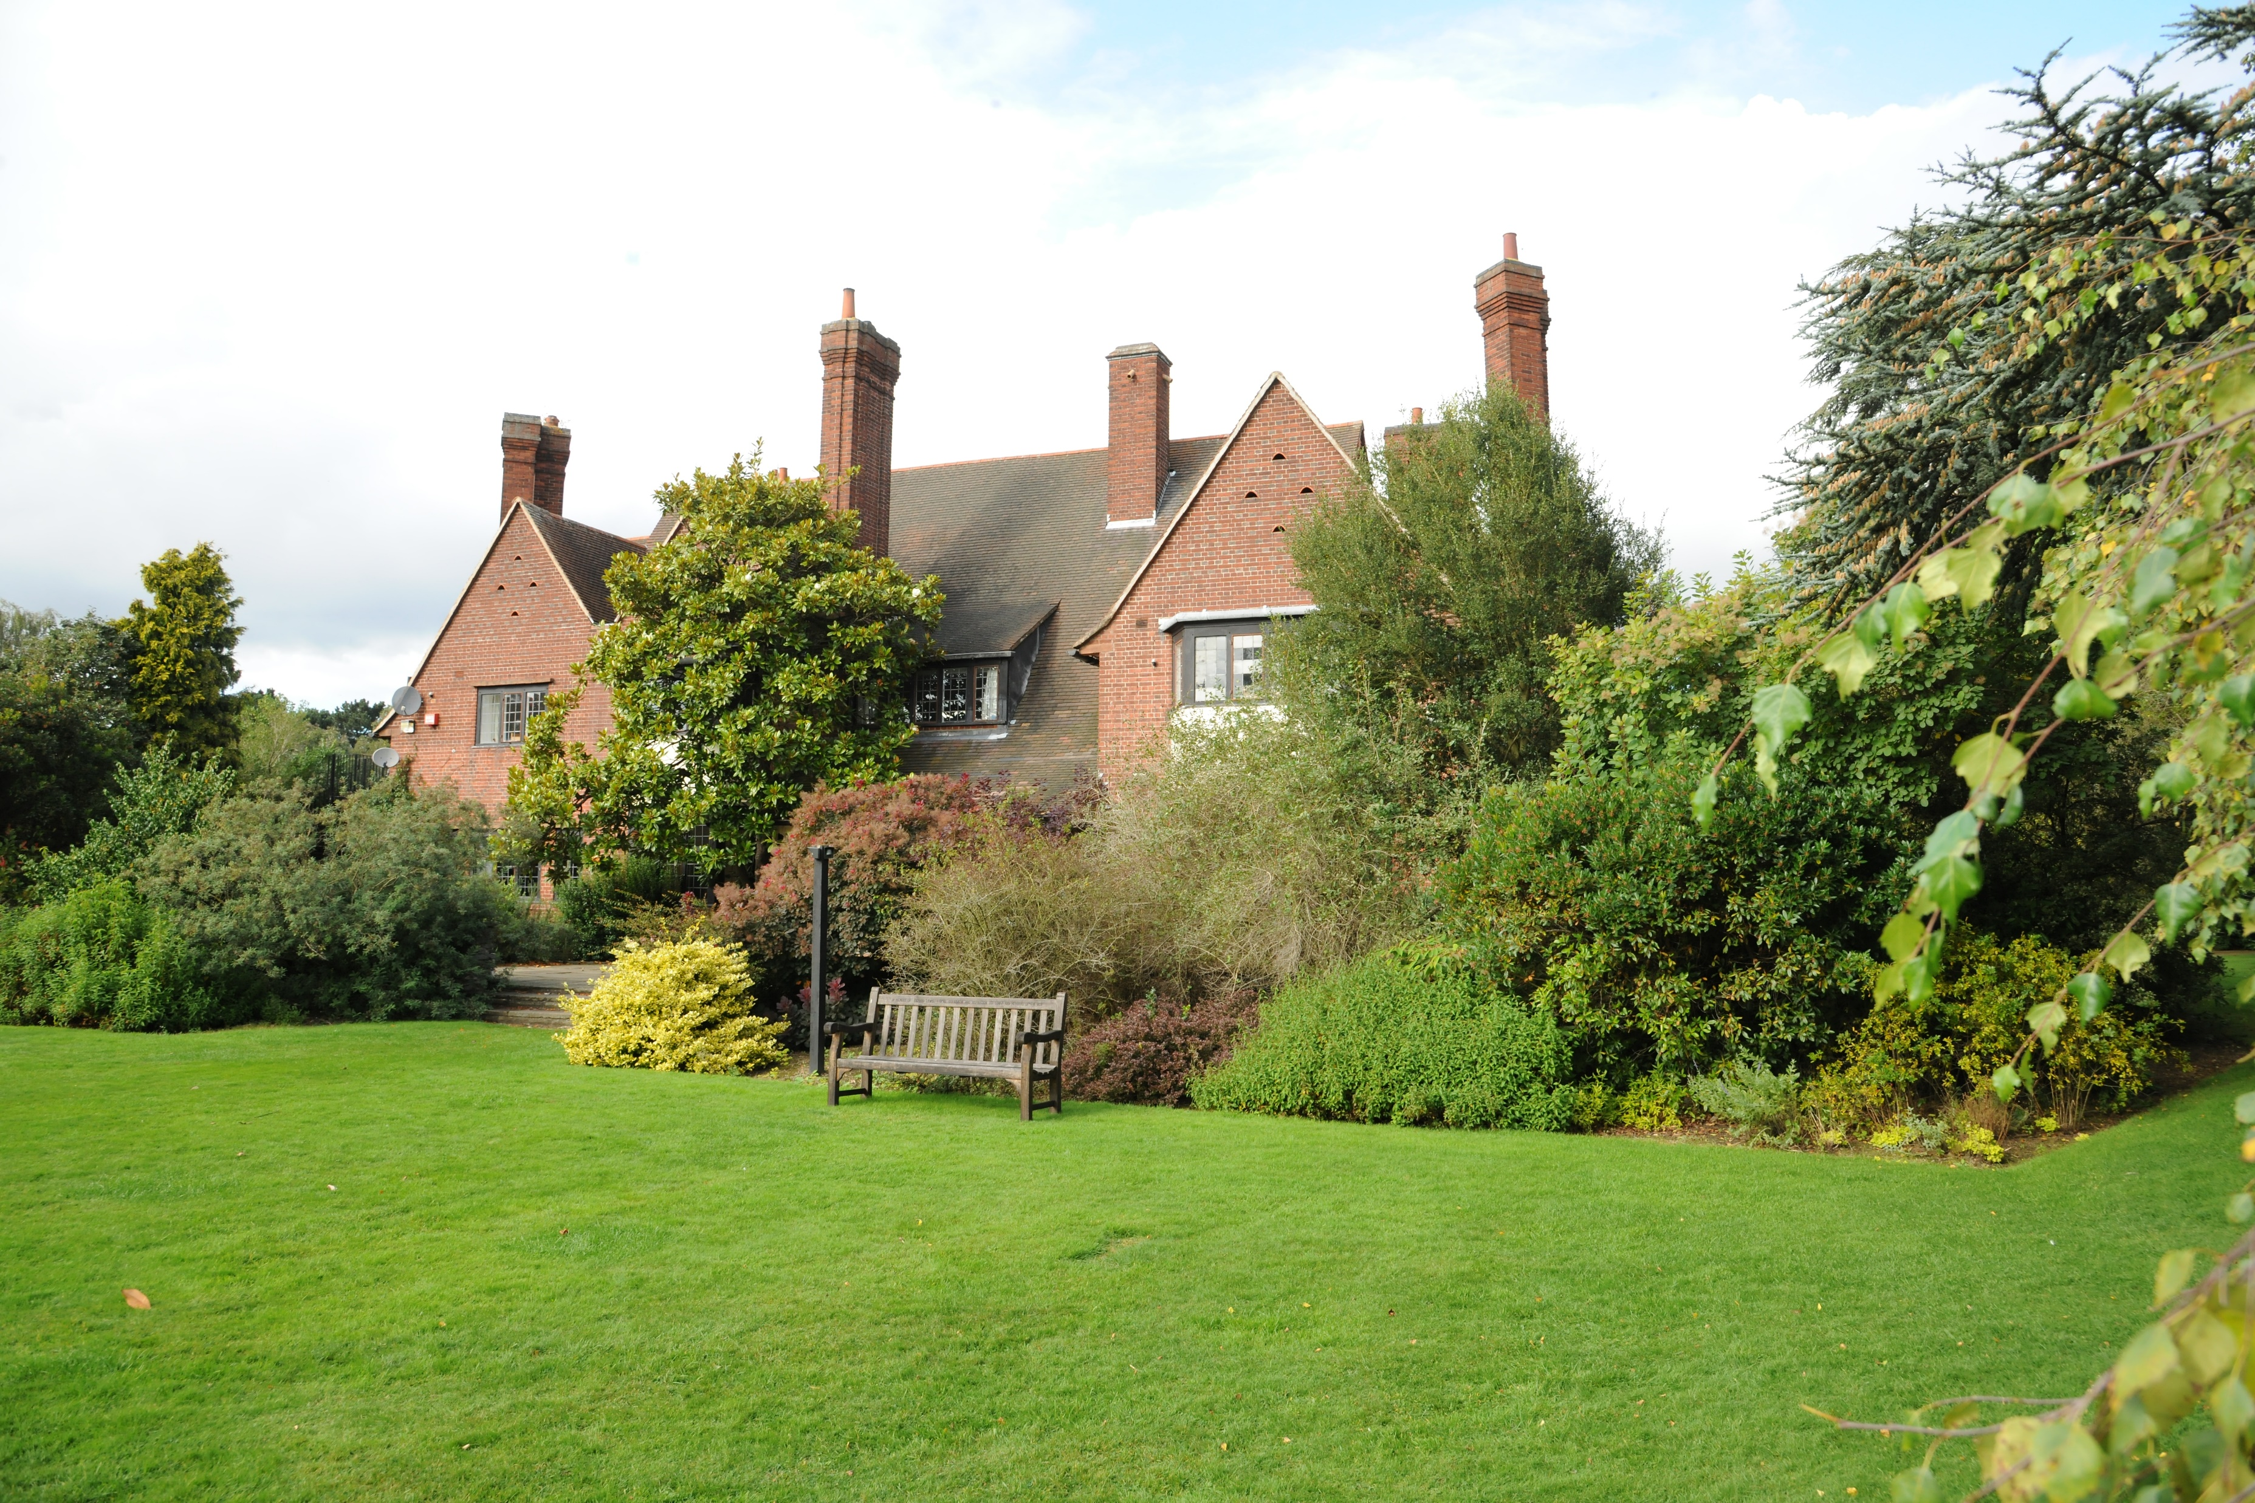
Our Year 1 trip to the Botanic Gardens

Slide 2
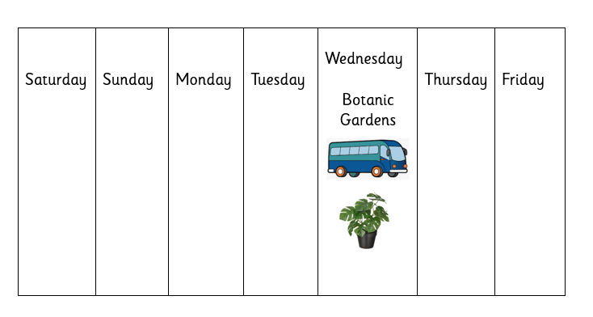
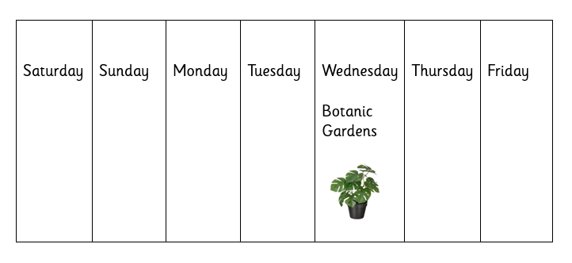
On Wednesday ___________ will take all the
children on a trip to the Botanic Gardens.
__________ will come with me.

Slide 3

On Wednesday I will arrive at school as normal and do_____________.
Then ________ will take me to the toilet.

Slide 4
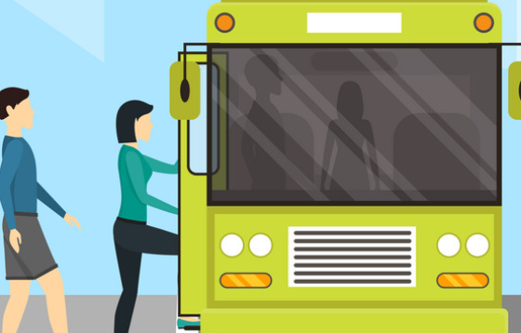
Then we will get on the bus to drive to the Botanic Gardens.
I will sit with____________.

Slide 5

The bus journey will be quite long.
It might be noisy on the bus.
If it is too noisy, I could wear my ear defenders.

Slide 6
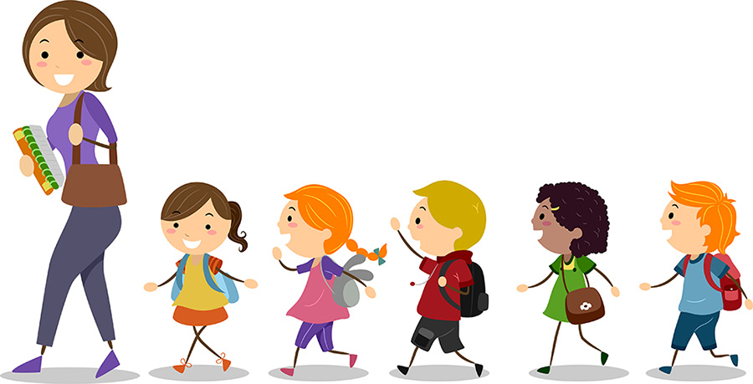
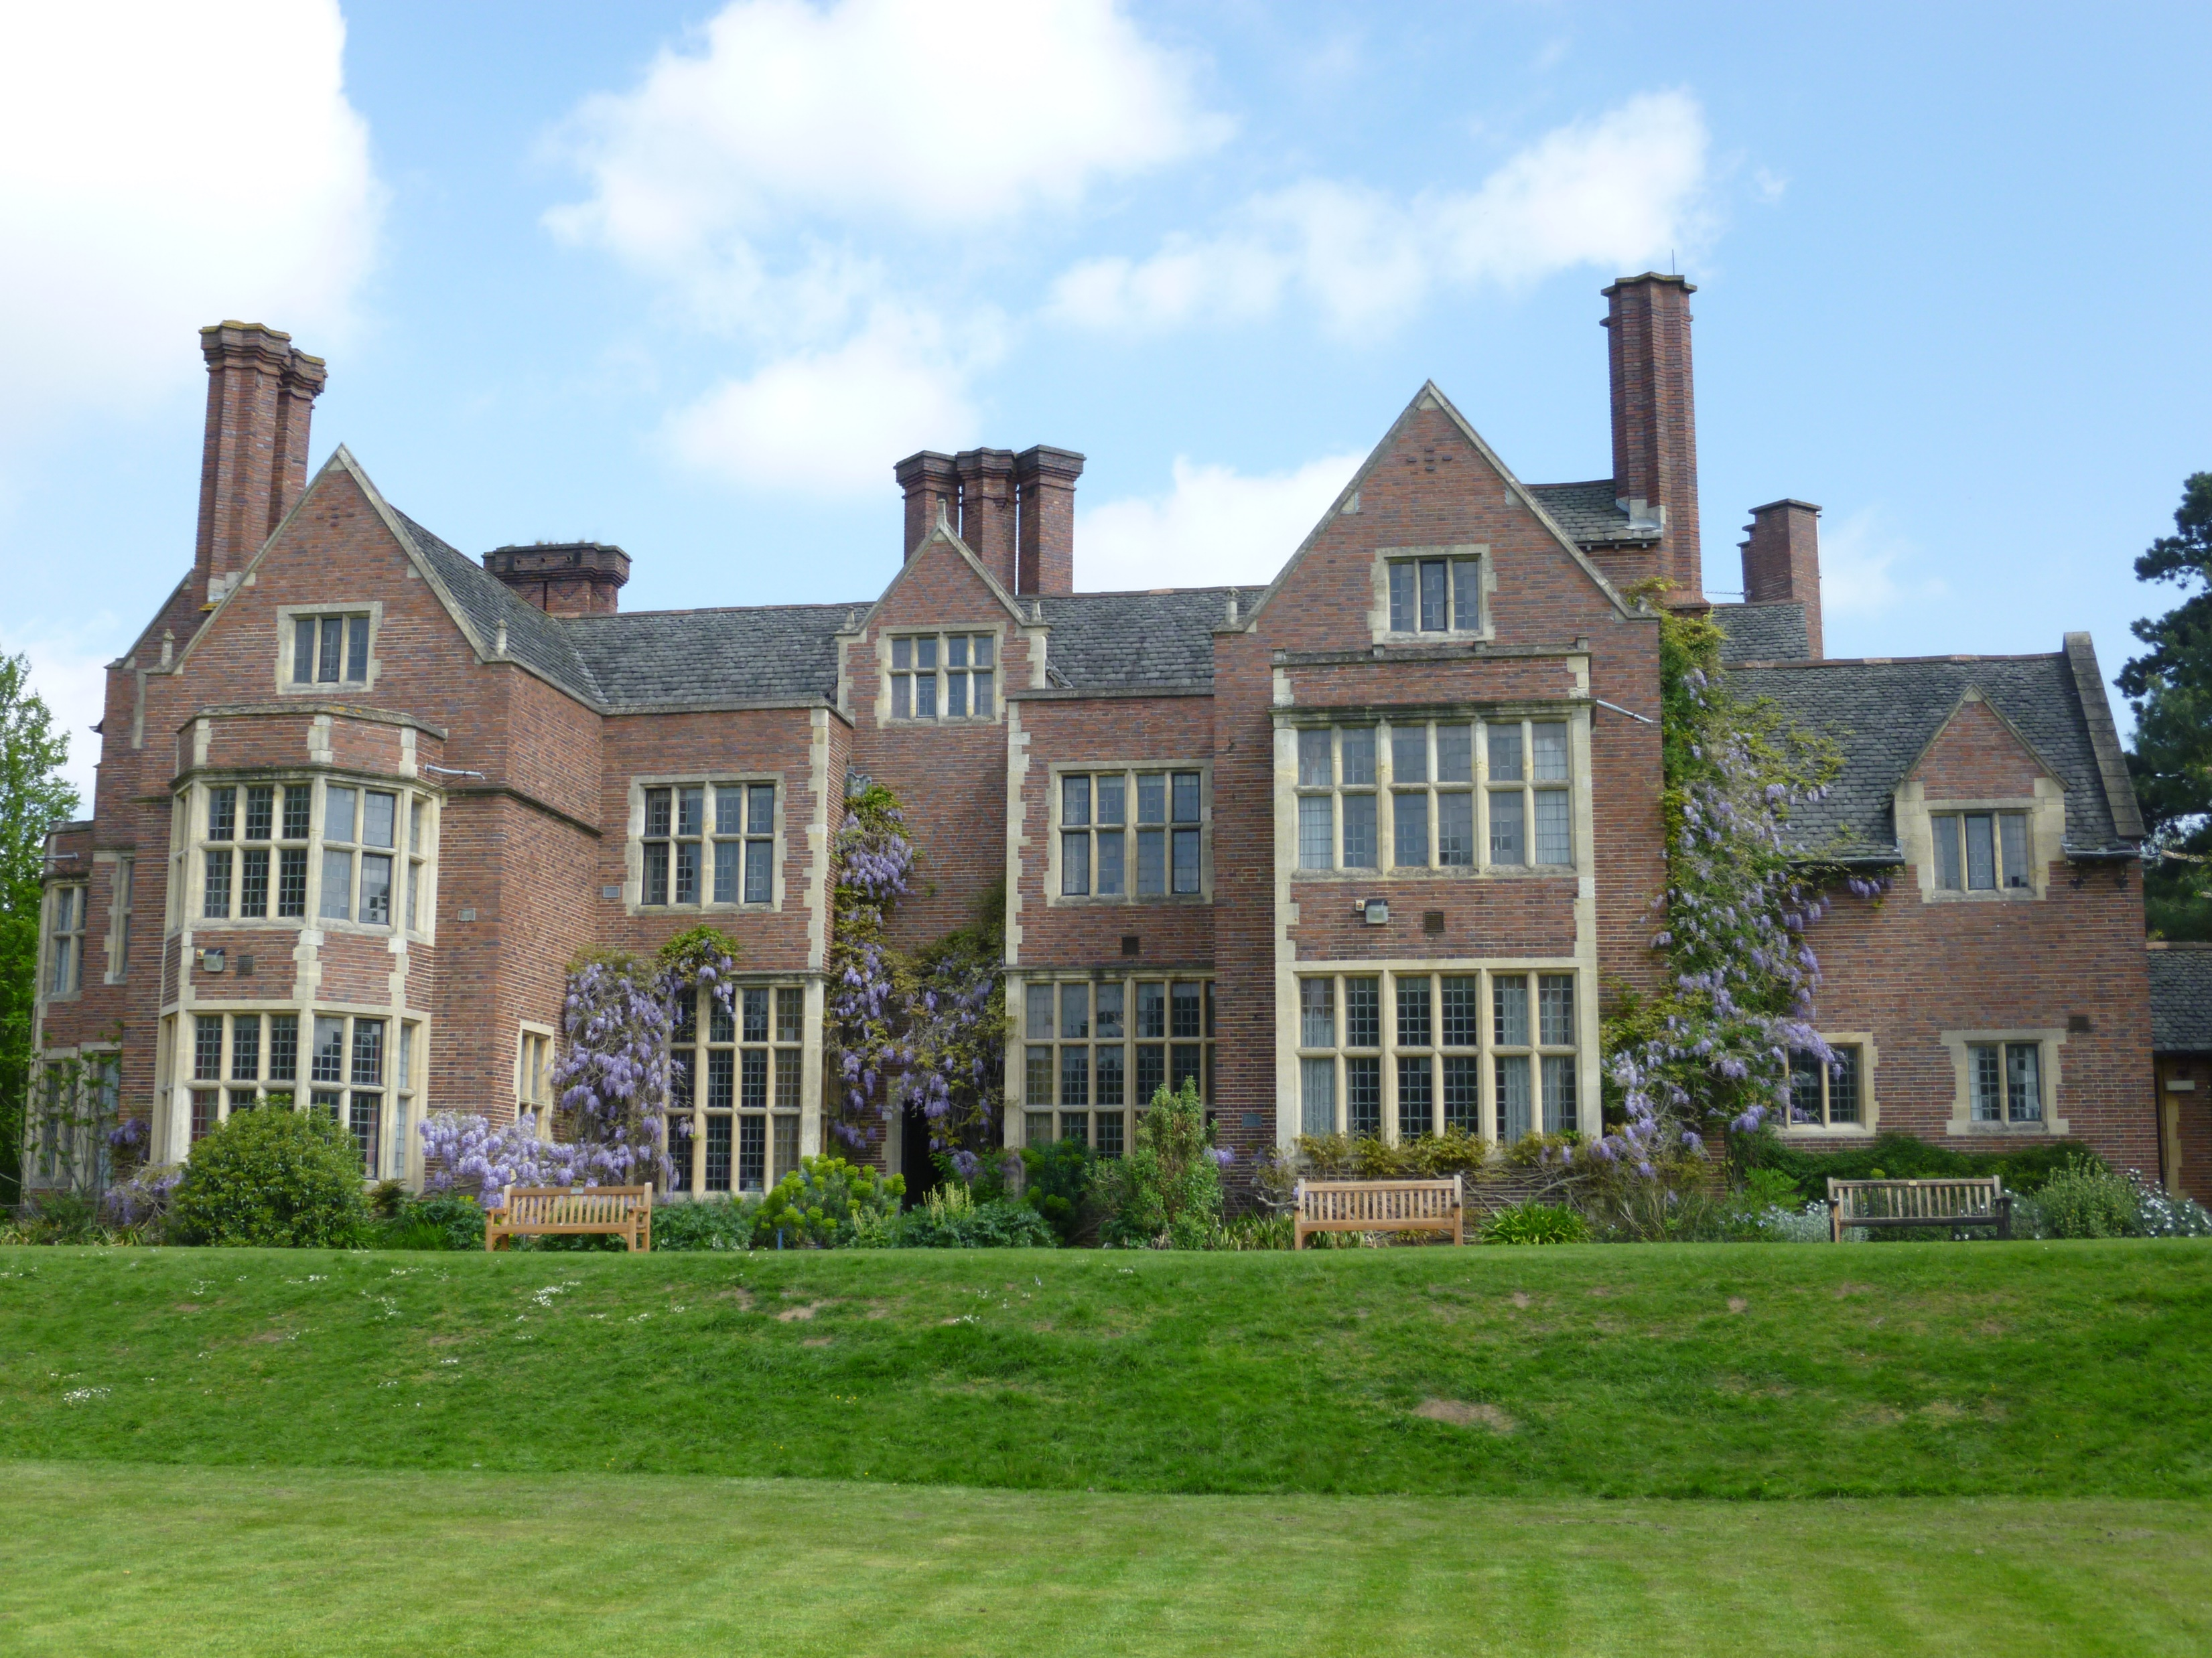
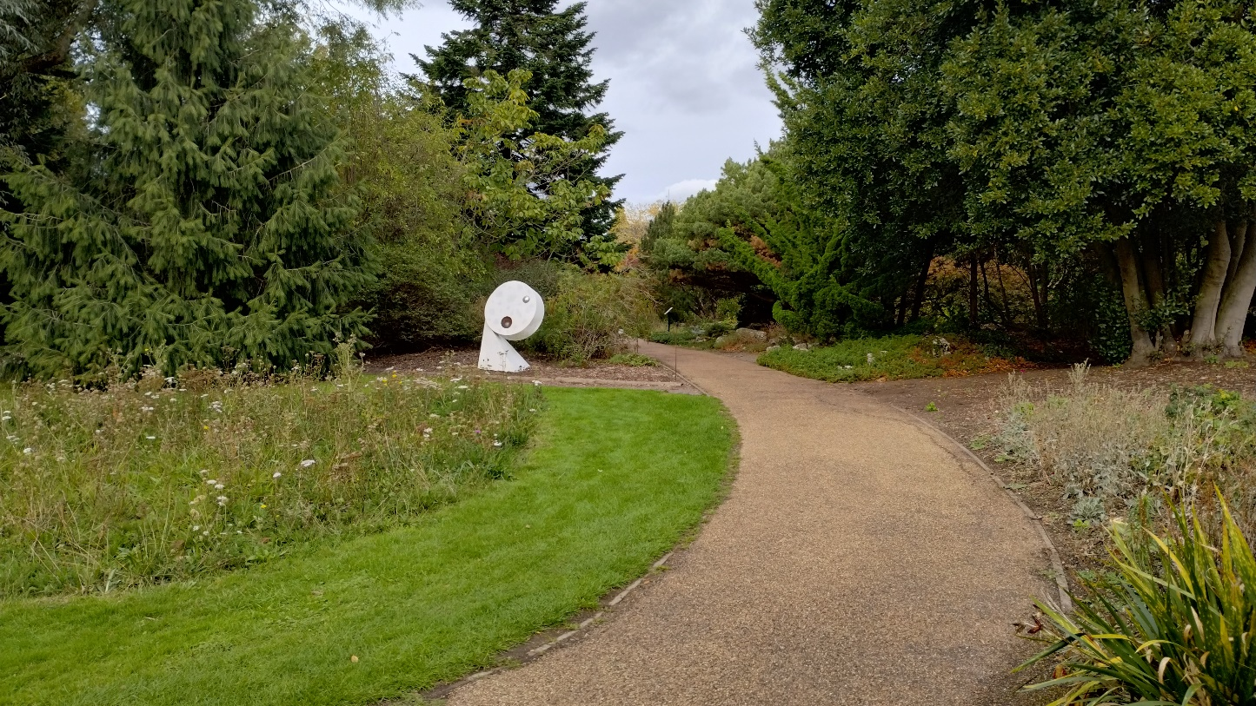
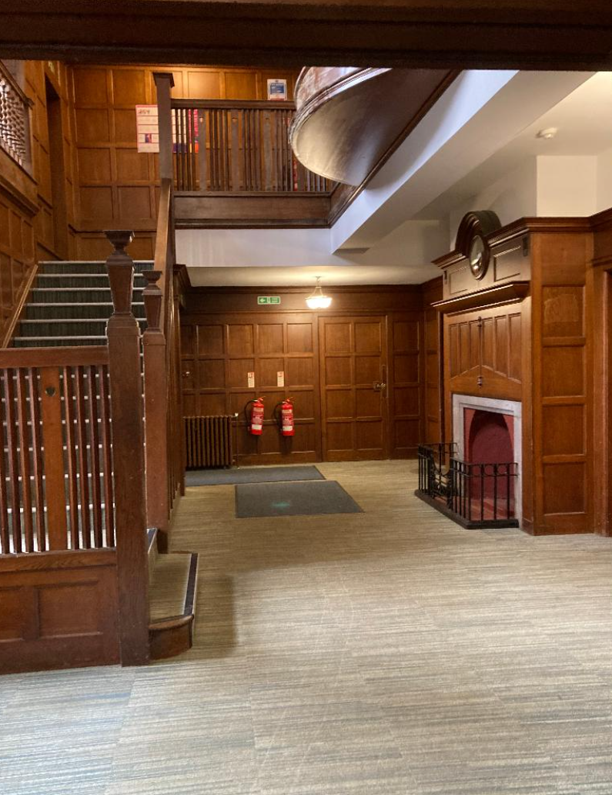
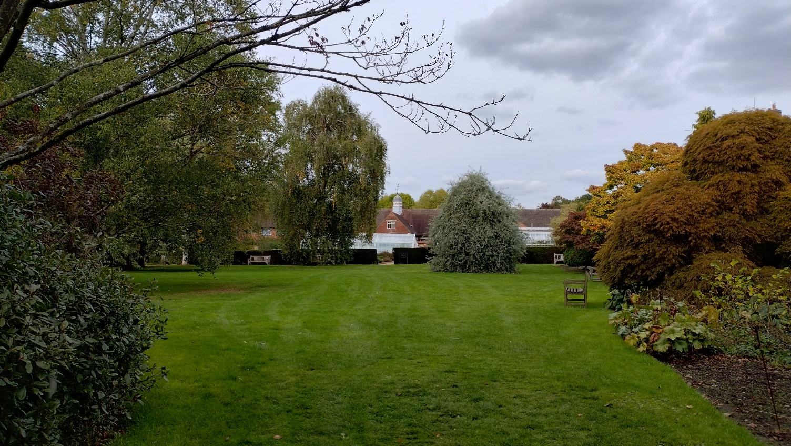
When we get to the Botanic Gardens, we will have a short walk to the hall.

Slide 7
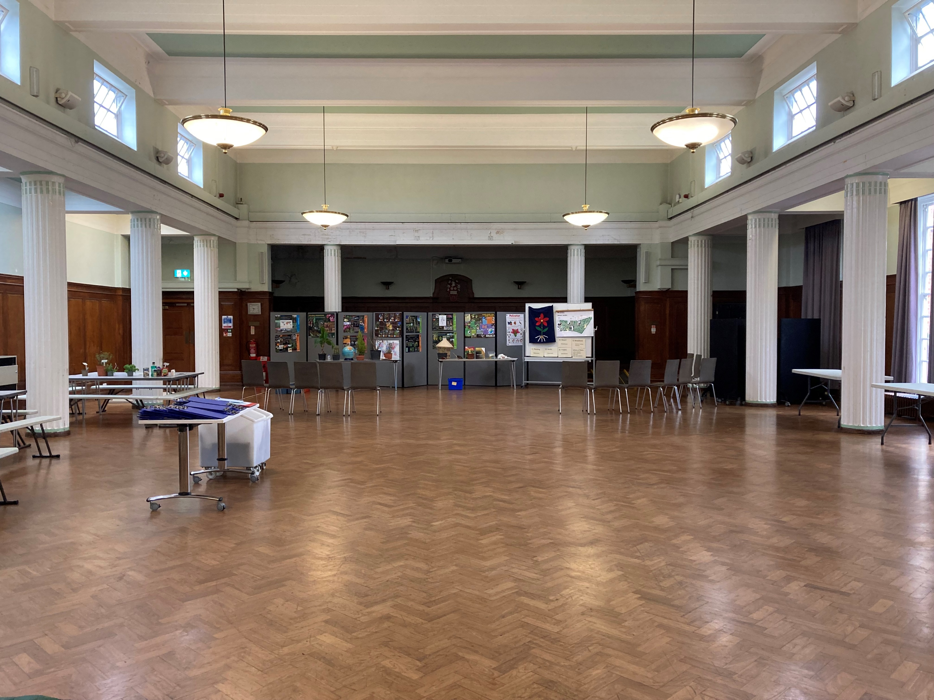
In the hall we will put down our bags and have a talk. I can use my ear defenders if it is loud.

Slide 8
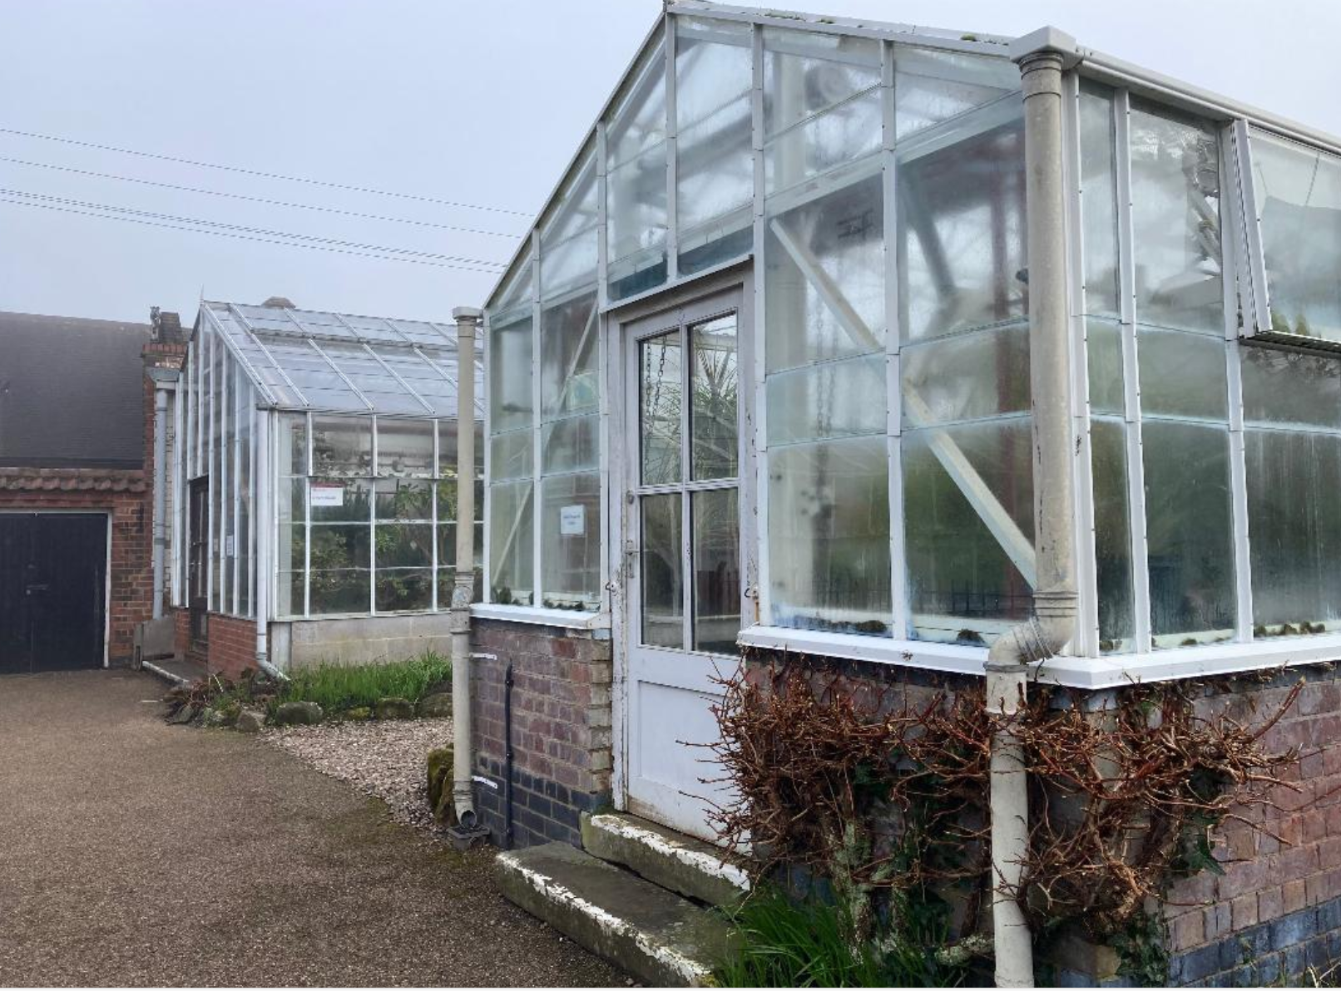
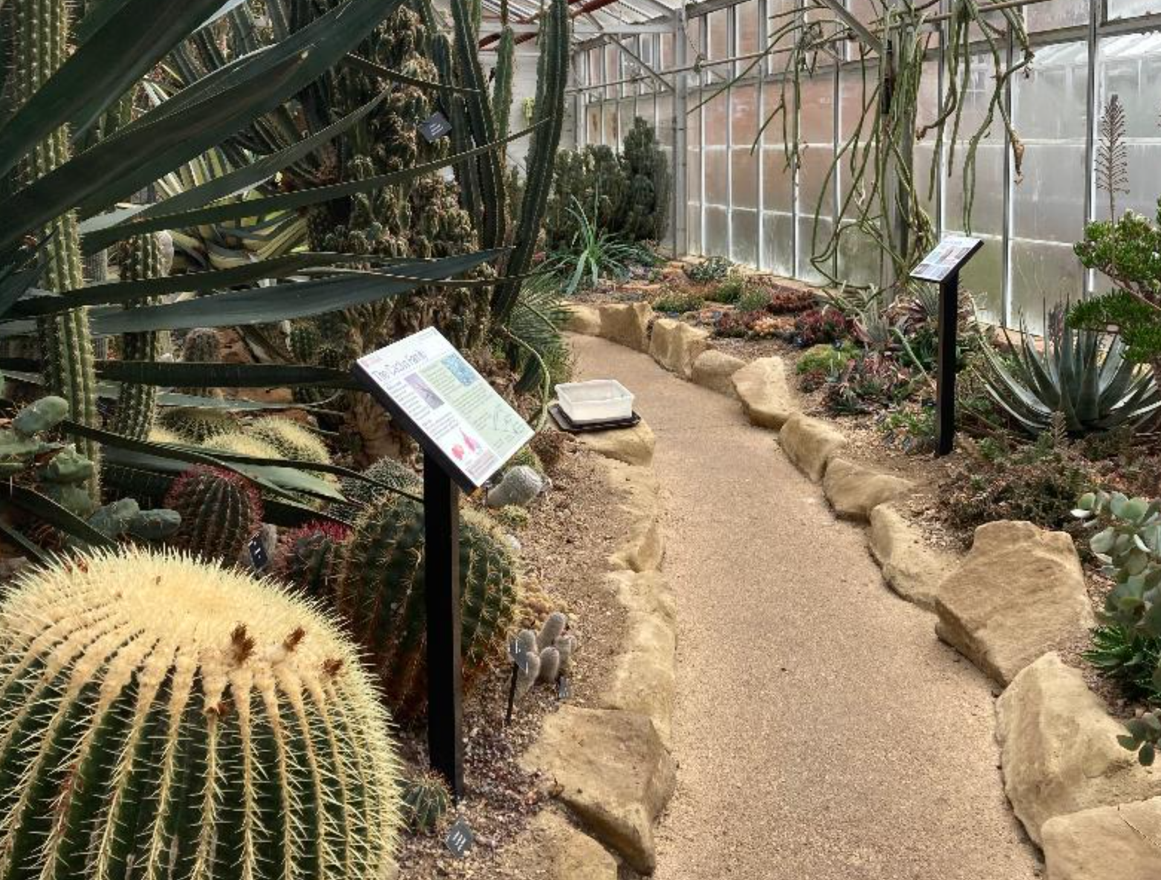
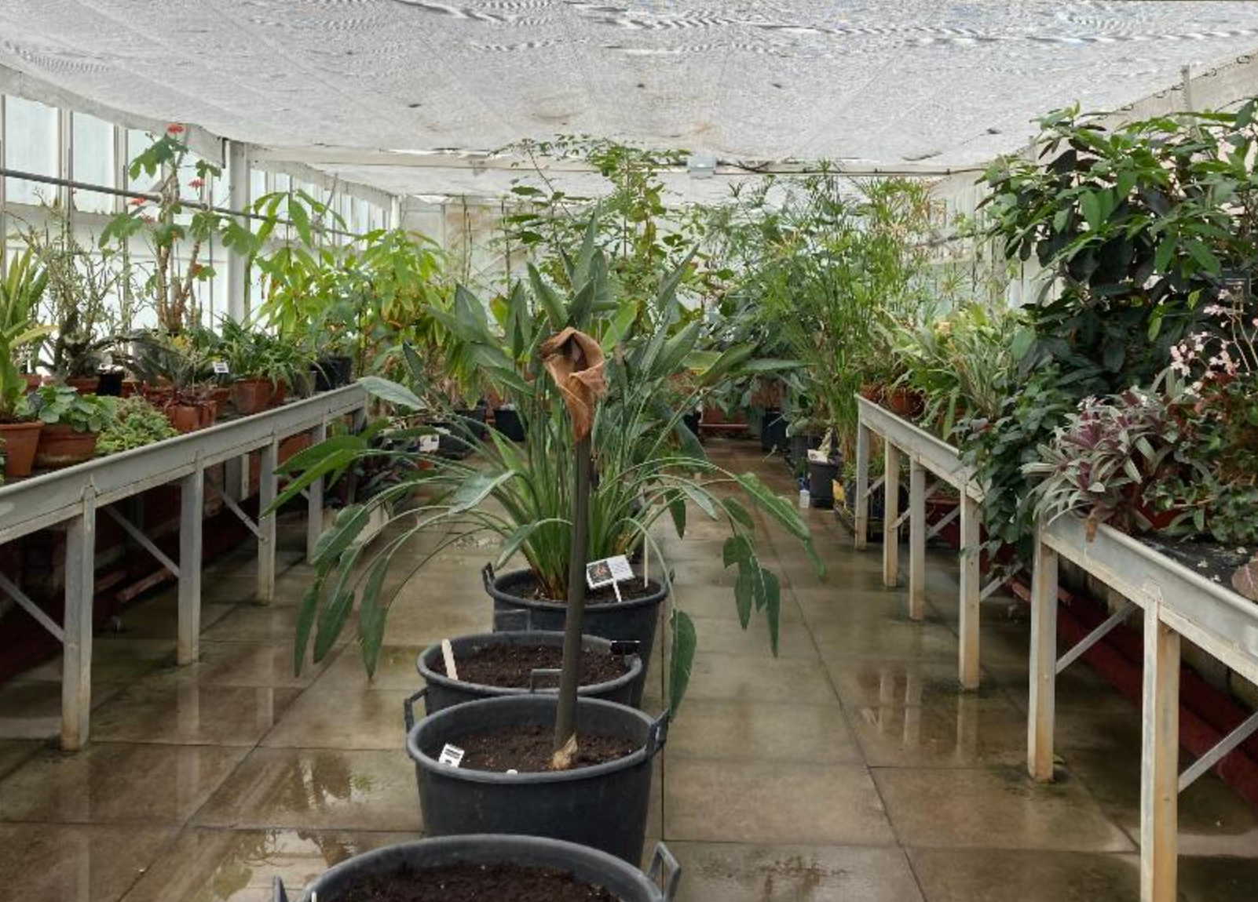
We will look in the greenhouses.

Slide 9
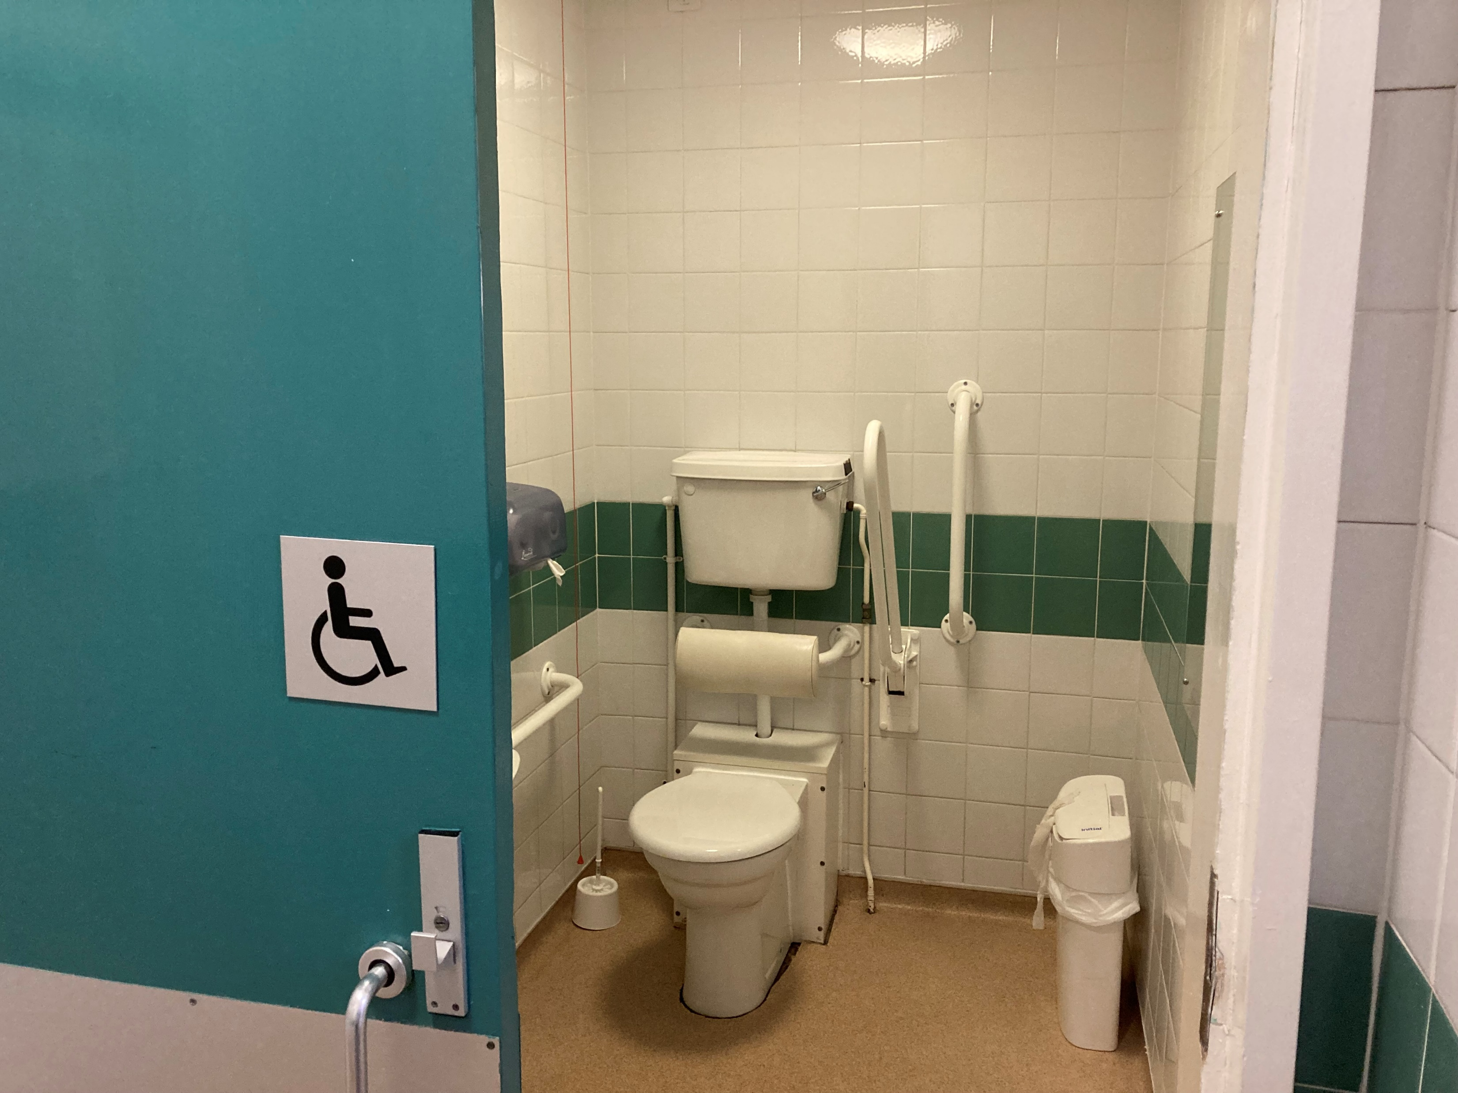
Then we will use the toilet.

Slide 10

At lunchtime we will all eat our packed lunches together.

Slide 11
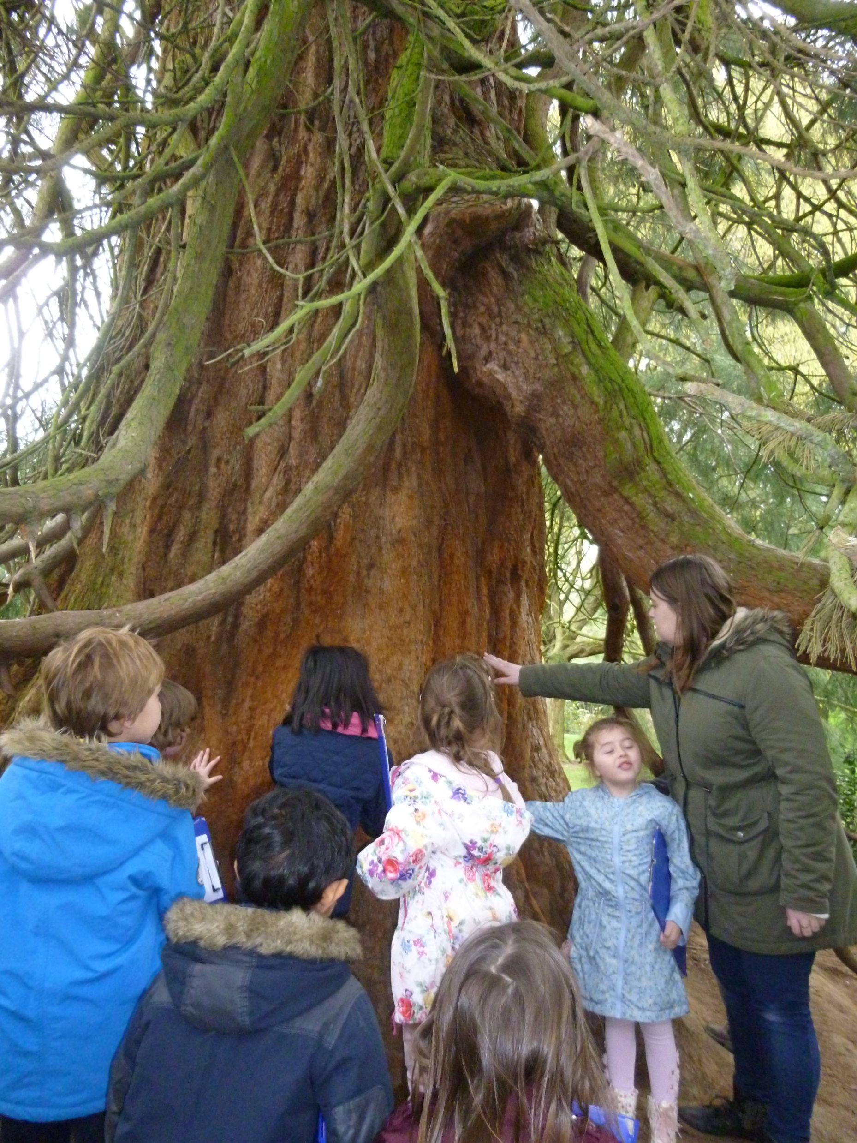
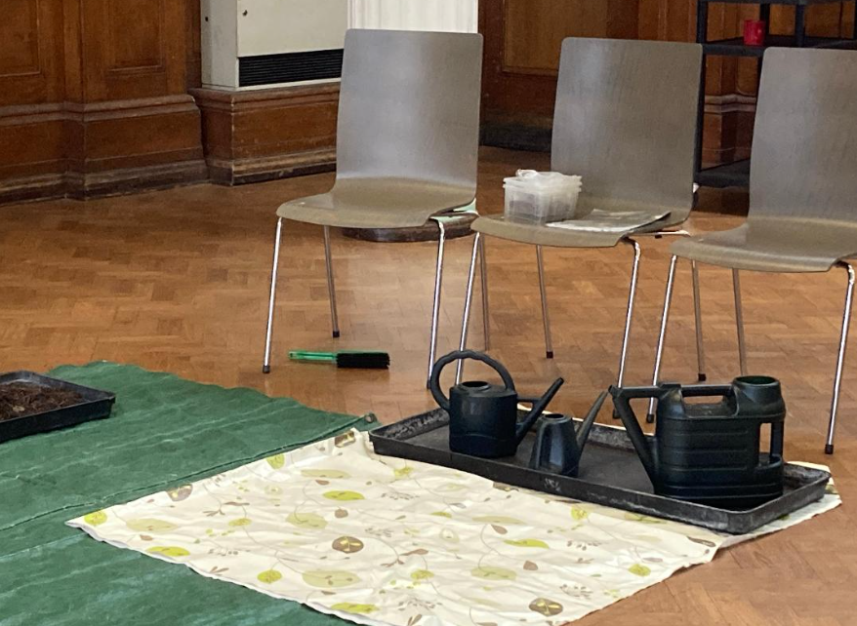
After lunch we will do some more activities in the gardens and the hall.

Slide 12
If I feel worried, I can tell__________.
They will help me to feel more calm.

Slide 13
When it is time to leave, we will walk back to the bus and travel back to school.
It will be time for After School Club.

