Slide 1
Health measurement
Department of Health Sciences

Slide 2
By the end of this lesson I will:
Be able to discuss what a health researcher does.
Talk about the different ways we can measure health.
Choose the correct unit and accurately measure height and weight.

Slide 3
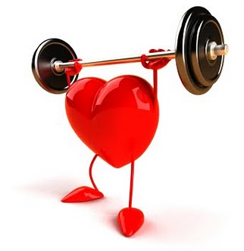
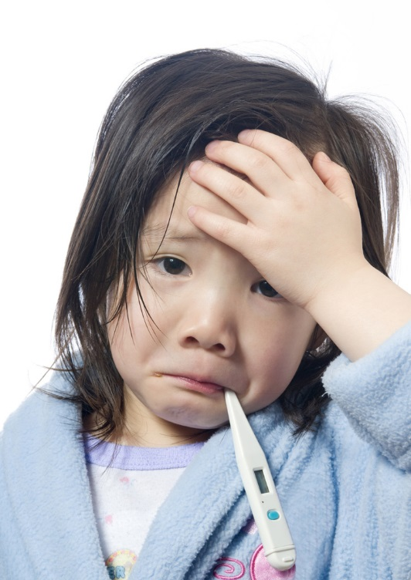
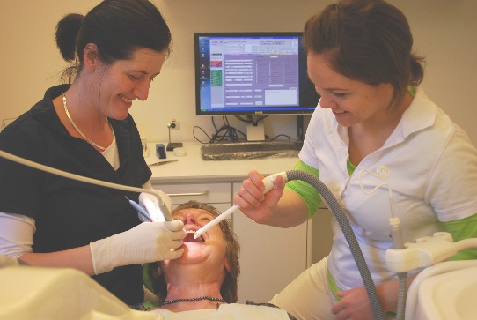
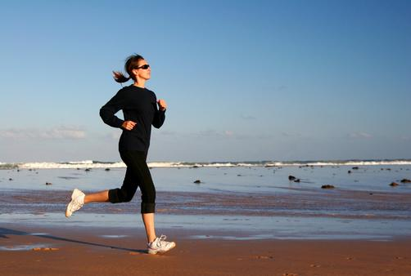
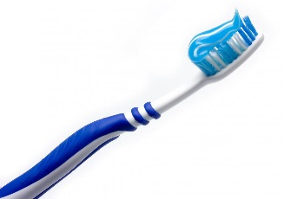
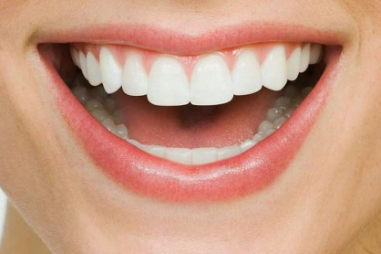
What is health?

Slide 4
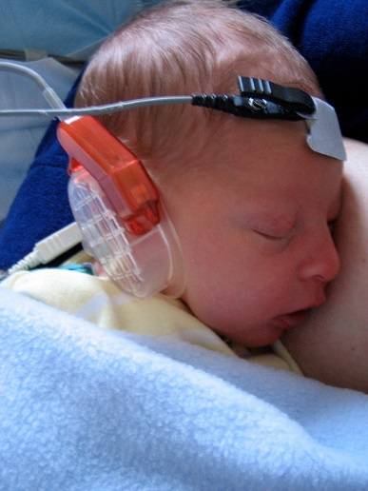
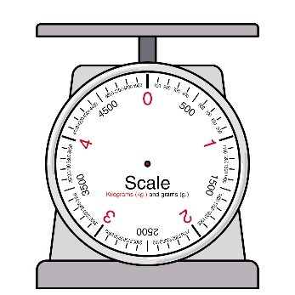
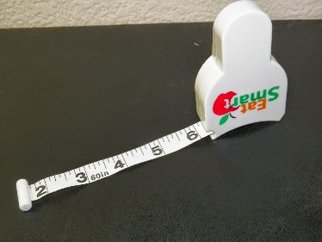
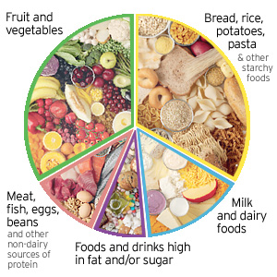
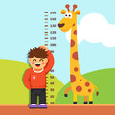
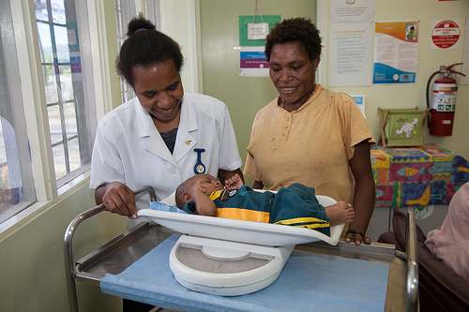
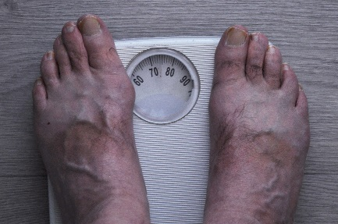
How can we measure health?

Slide 5
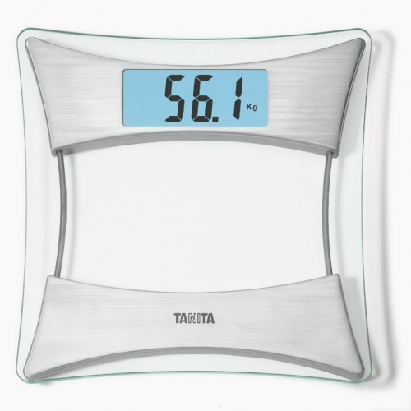
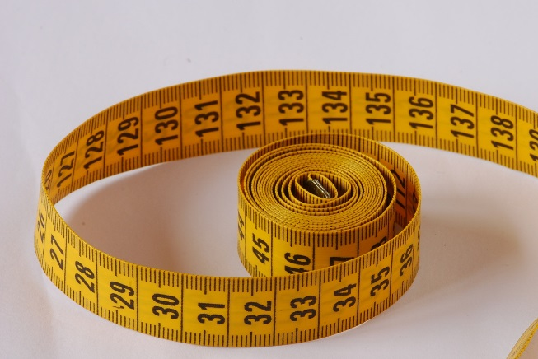
Why measure height and weight?
In reception you may have had your height and weight measured.
Measuring height and weight is a good way to know how you are growing.
You are going to pretend to be a health researcher and measure your height and weight today.
What do you use to measure height or weight?
What units are the measurements in?

Slide 6
Activity:

Slide 7
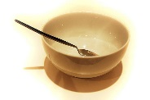
Extension:
How many people ate a healthy breakfast today?
 | Healthy Breakfast | Unhealthy Breakfast | No Breakfast
Tally
Number:

Slide 8
Today I have learnt:
What a health researcher does.
The different ways we can measure health.
How to accurately measure height and weight.

