Slide 1
Covid in Cartoons
Dr Fransiska Louwagie

Slide 2
Covid in Cartoons
Empowering a thick narrative of the crisis by promoting cultural literacy and diversity skills amongst vulnerable young people
Working with cartoons and political cartoonists to engage young people
build cultural literacy and foster processes of meaning-making in relation to the current pandemic.
engage young people in building a critical narrative of the crisis and its impact.
promote a sense of belonging, agency and resilience amongst disadvantaged young people
promote an inclusive social response and curriculum

Slide 3
Covid in Cartoons
PI: Dr Fransiska Louwagie, University of Leicester, School of Arts, Associate Professor of French Studies
Co-I: Dr Diane T. Levine, University of Leicester, Deputy Director of the Leicester Institute for Advanced Studies
Research Associates: Dr Kara Blackmore; Dr Sarah Weidman
External Partners: Cartooning for Peace; Shout Out UK
Admin, impact and Communication: Charlotte King (LIAS)
4 January 2021-3 July 2022

Slide 4
Covid in cartoons
Minicourse for target schools: 800 to 1,000 students (15 to 18 years old)
Open Access resources
Questionnaires and focus groups
Collaborations with international cartoonists (co-creation of resources)
Research publications
Collaborations with relevant research and public engagement projects (online exhibition, anthology, end-of-project film)

Slide 5
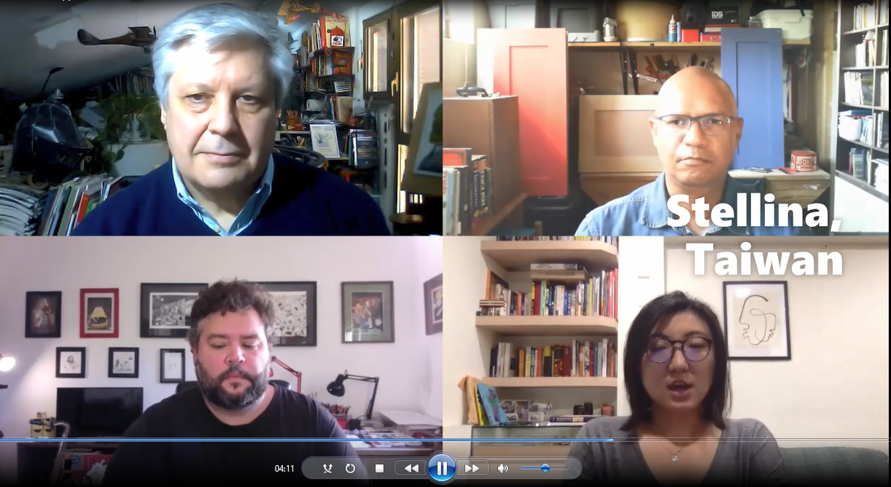
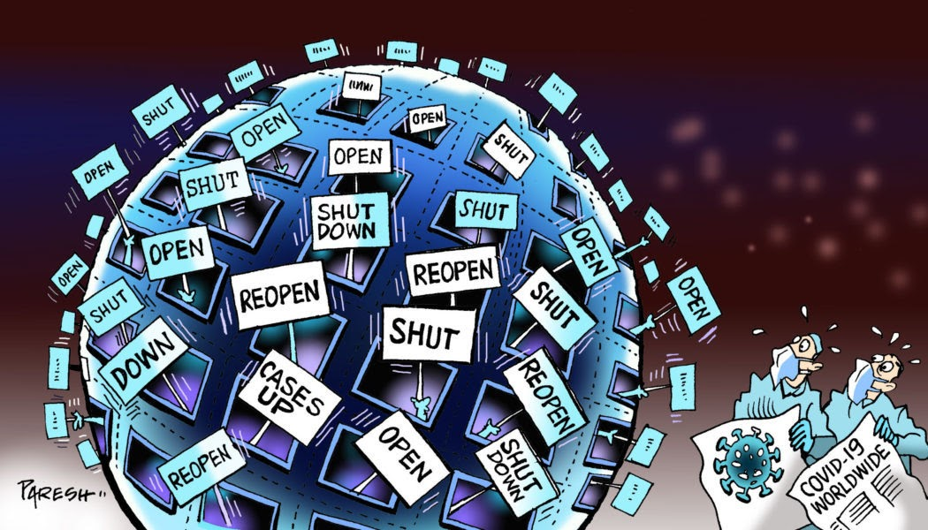
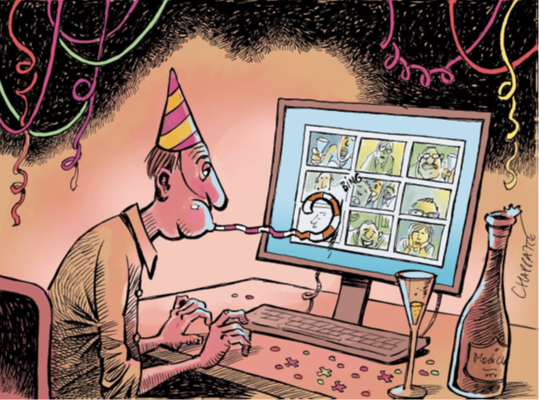
Experiences and narratives of the pandemic

