Slide 1
Embedding Employability
The Natural Sciences Teaching Team at the University of Leicester
HEA CATE Award winners 2017
Notes:
Kath
Hello. I am … and my colleague today is … . We are part of the NS teaching team etc etc.
I am going to start by introducing the structure of the workshop

Slide 2
Workshop Programme
1. Welcome and Introduction: PVC Erewhomes University
2. Address by Head of Department of Cryptozoology
3. Initial group discussion on the issues
4. Embedding Employability through Authentic Assessment: Invited Lecture
5. The Employability Matrix
6. Group discussion and feedback
7. Embedded employability in UoL Natural Sciences
-the programme
-the outcomes
-central support
8. Individual/group reflection on application in your own context
9. Workshop evaluation
Notes:
Welcome and Introduction:
Division of labour for two leaders, A and B:
This introduction: B (or C): 1. A; 2. B; 3. A and B facilitate; 4. B; 5. A 6. A and B facilitate 7. A (or C)
I will begin by explaining the problems in our Department of Cryptozoology which will provide a context for your discussion of employability. To help with the discussion we’ll have a lecture from my colleague which will include some recorded contributions from experts who cannot be with us today. We’ll ask you to feed back very briefly on your discussions. We’ll then look at a specific example of how employability is embedded in the Natural Sciences programme at Leicester. And we’ll ask you to reflect on what you might take away from this workshop for your own context. While much of the initial focus will be on curriculum planning, the important point is that employability can be embedded from the top down or the bottom up – you can start from a blank sheet and a master plan or from a step-by-step approach at module or sub-module level. Finally we’ll ask for your feedback.

Slide 3
Embedding Employability
A Crisis in the Department of Cryptozoology
Disclaimer
The Department of Cryptozoology is a fictional work of exaggeration for the purpose of illustration and any resemblance to a real department is purely accidental
Notes:
Kath

Slide 4
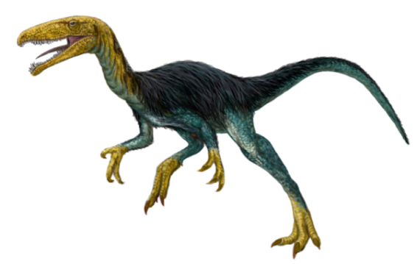
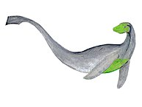
Issues in the Department of Cryptozoology
Address by the PVC (Teaching and Learning)
By Carnby - Own work, CC BY-SA 4.0, https://commons.wikimedia.org/w/index.php?curid=45016080
Notes:
Cheryl

Slide 5

The Issues
Research
  5* Top Department in this field in the Country
Teaching
  NSS scores: How can we improve these?
  TEF: How can we support the Department?
Notes:
First congratulate on research: May note that there really are real courses in cryptozoology and “real” researchers
Teaching is where the issues are. NSS: below average on every measure; TEF – what does the Department contribute to excellence in teaching?
If delegates are from T&L background - How can the Dept be SUPPORTED in developing?
If delegates are academic staff: how can the curriculum delivery be improved?

Slide 6
Address by Head of Department
Notes:
HoD takes audience through the background data DEFENDING HIS/HER Department

Slide 7

The CZ Curriculum
Extract from Departmental Handbook
External examiner report
Employment data
NSS scores
Retention data
Student achievement
Notes:
These are the topics I will discuss
These materials will be provided as handouts. You may not need all the details.

Slide 8
The Cryptozoology Curriculum
Unless otherwise stated modules comprise [15] lectures and are assessed by a 2000 word essay and a {2} hour exam.
Year 1
Introduction to statistical analysis | Evolution and Speciation
Logic: reference and meaning {1.5 hours} | Cladistics
Biophysics 1 | Physiology
Year 2
Advanced statistical analysis | Zoology, Geography and World Heritage
Detector physics | Mythical Beasts of Antiquity [20 lectures]
Biophysics 2 | Social Theories
Year 3
Crypto-zoology in Fiction [30] {two 2000 word essays} | Forensic crypto-zoology (A history of scientific fraud) [30]
Freud, Jung, Adler and the Collective Unconscious | Research Project or Literature Project
Notes:
These materials will be provided as handouts – the speaker goes through these DEFENDING THE DEPARTMENT -!!!
Here is a wide-ranging and contemporary curriculum linked to current research themes as you would expect from a 5* Department; each topic chosen by an expert with therefore sole responsibility for content and level. (Lecturer knows best.) Some students find this a very rigorous diet, but we like that; we have to maintain the very highest academic standards.

Slide 9
Student Handbook (Extract)
The structure of the Degree
The degree runs over three years.
Each year comprises 6 modules.
Each module is 20 credits.
Each module is assessed by a 2-hour examination, unless otherwise stated
Each examination paper contains FOUR questions of which students must answer THREE
In the final year high performing students will be given the option of substituting a research project for the literature review
Modules:
Each module is delivered by an academic member of staff who is responsible for the content of the module. Modules consist of 15 lectures and an assessed essay. Lectures at their discretion may introduce additional continuous assessments such as a presentation.(Details will be found on the handout for each module.)
SUPPORT
Each student is assigned a personal tutor who may ask to see his (or her) tutees once a term. Staff have office hours during which they may be consulted or appointments may be made through the Teaching Office.
Notes:
The course is well-established, with little need to amend the traditional delivery and clearly structured.

Slide 10
External Examiner’s Report
To: The President and Vice-Chancellor
University of Erewhon
Report on Department of Crytozoology
From: Professor Wise
University of Poppleton
EXTRACT:
The examination papers were of a very high level with a good range of questions covering all of the main crytospecies and their evolution. The physiology module brought together a number of interesting philosophical issues and the social theories module gave an excellent overview on the post-modern approach to scientific hermeneutics. The Department is clearly very committed to bringing their own research into the curriculum.
The organisation of the papers was exemplary, with each having the same length (2 hours) and structure (write three essays from a choice of four) and the similarity to papers from previous years gave students ample opportunity to practice. The papers were marked very rigorously.
I was please to see that this year the Department awarded two first class degrees, with almost half the class achieving 2(i)s. The two first class awards were well-deserved and the students will be well-prepared for academic research. The tightening of the progression criteria has led to only four failures in the final year this year.
The Department continues to provide a very academic environment that nurtures research talent through a sound traditional approach to teaching. Some of the students I met were a little bit critical of the relevance of the degree for their future employment, but they had clearly failed to engage with the research culture of the Department.
Notes:
The Department is well-respected in research and brings research into the curriculum. The assessment is rigorous with no dumbing down.

Slide 11
Employment
https://www.hesa.ac.uk/stats-dlhe
% employed by subject area
Subject area | Employed | Unemployed
Medicine & dentistry | 90.6% | 1.0%
Biological sciences | 69.9% | 6.2%
Veterinary science | 91.2% | 3.2%
Agriculture & related subjects | 71.2% | 5.5%
Physical sciences | 63.9% | 7.4%
Mathematical sciences | 64.0% | 7.5%
Computer science | 75.7% | 10.5%
Cryptozoology | 63.5% | 11.2%
Engineering & technology | 77.2% | 6.8%
Architecture, building & planning | 85.0% | 4.8%
Social studies | 75.1% | 6.4%
Law | 67.6% | 5.1%
Business & administrative studies | 80.1% | 6.8%
Mass communications & documentation | 80.0% | 8.6%
Languages | 68.6% | 6.4%
Historical & philosophical studies | 65.9% | 6.3%
Creative arts & design | 77.7% | 7.5%
Education | 89.8% | 1.8%
Combined | 67.5% | 3.9%
The salaries of Cryptozoologists in the US range from a low of $10,085 to a high of $237,999, with a median salary of $43,006.
Notes:
Cryptozoology is a highly selective profession with good rewards for the successful – the Department prepares students for the competitive environment without of course guaranteeing that all graduates will get employment in the profession.

Slide 12
National Student Survey % satisfaction
National Student Survey
Sector results for full-time and part-time students - England
Question
The teaching on my course | Sector | CZ
1 - Staff are good at explaining things. | 90 | 80
2 - Staff have made the subject interesting. | 83 | 83
3 - Staff are enthusiastic about what they are teaching. | 88 | 95
4 - The course is intellectually stimulating. | 85 | 85
Assessment and feedback
5 - The criteria used in marking have been clear in advance. | 76 | 72
6 - Assessment arrangements and marking have been fair. | 76 | 80
7 - Feedback on my work has been prompt. | 69 | 65
8 - I have received detailed comments on my work. | 71 | 70
9 - Feedback on my work has helped me clarify things I did not understand. | 66 | 65
Academic support
10 - I have received sufficient advice and support with my studies. | 79 | 79
11 - I have been able to contact staff when I needed to. | 86 | 75
12 - Good advice was available when I needed to make study choices. | 78 | 78
Organisation and management
13 - The timetable works efficiently as far as my activities are concerned. | 81 | 81
14 - Any changes in the course or teaching have been communicated effectively. | 78 | 80
15 - The course is well organised and is running smoothly. | 76 | 75
Learning resources
16 - The library resources and services are good enough for my needs. | 87 | 87
17 - I have been able to access general IT resources when I needed to. | 89 | 89
18 - I have been able to access specialised equipment, facilities or room when I needed to. | 83 | 83
Personal development
19 - The course has helped me present myself with confidence. | 81 | 75
20 - My communication skills have improved. | 85 | 75
21 - As a result of the course, I feel confident in tackling unfamiliar problems. | 82 | 75
Overall satisfaction
22 - Overall, I am satisfied with the quality of the course. | 86 | 79
Students' Union
24 - I am satisfied with the Students' Union (Association or Guild) at my institution. | 68 | 68
Notes:
Note these are generally quite good – and not at all as bad as some of our critics in the University would make out. The problem of employability is in the nature of the discipline – we can’t guarantee jobs for our graduates, so that doesn’t worry me. We have a good staff-student ratio – we like that because it allows us to get on with our research, which, as you have heard, is 5*. We wouldn’t want to endanger that.

Slide 13
Retention of Students By Discipline
Table 17: Retention of students by discipline
Discipline | % of students leaving with no reward | Number | % total continuing or successfully completing studies | % total students gaining lower or no award
Sector as a whole |  |  | 94 | 6
Art and Design | 6 | 4,029 | 94 | 6
Biological Sciences | 3 | 1,785 | 94 | 5
Built Environment | 4 | 1,967 | 94 | 6
Business and Management | 4 | 5,161 | 94 | 6
Computer Science | 6 | 3,966 | 91 | 9
Economics | 2 | 408 | 97 | 3
Education | 5 | 4,975 | 94 | 7
Engineering | 4 | 4,229 | 94 | 7
English | 3 | 1360 | 96 | 4
Finance and Accounting | 4 | 1,102 | 95 | 5
GEES | 2 | 719 | 97 | 3
Health | 3 | 2,676 | 95 | 5
History | 3 | 1,292 | 97 | 4
Hospitality, Leisure, Sport and Tourism | 5 | 3,128 | 92 | 8
Languages | 8 | 2,486 | 92 | 8
Law | 4 | 2,165 | 95 | 5
Marketing | 4 | 511 | 94 | 6
Maths and Statistics | 3 | 655 | 96 | 4
Media and Communications | 4 | 1,187 | 94 | 6
Medicine and Dentistry | 1 | 381 | 99 | 1
Music, Dance and Drama | 4 | 1,539 | 94 | 6
Nursing | 5 | 6,038 | 94 | 6
Other | 4 | 3,547 | 93 | 7
Philosophical and Religious Studies | 4 | 579 | 94 | 7
Physical Science | 4 | 1,241 | 94 | 7
Politics | 2 | 360 | 96 | 3
Psychology | 3 | 1,714 | 95 | 5
Social Work and Policy | 5 | 2,432 | 92 | 8
Sociology | 5 | 1,548 | 93 | 7
Veterinary Medicine | 3 | 286 | 95 | 4
Crytozoology | 13 | 8 | 85 | 15
Notes:
Retention is not as good as some other programmes, but this is a reflection of the rigorous nature of the programme. Some students don’t take the programme seriously enough and treat it as if it should be an easy way to a degree – it isn’t. We need this rigour to defend the programme against those who might call it a mickey-mouse degree.

Slide 14
Student Attainment by Discipline
Attainment of a ‘upper degree’ by discipline
Discipline | % of students achieving a ‘upper degree’ | Number | % of students not achieving a ‘upper degree’ | Number
Sector as a whole | 65 |  |  |  |  | 35
Art and Design | 61 | 13,973 | 39 |  | 8,847
Biological Sciences | 65 | 6,748 | 35 |  | 3,667
Built Environment | 63 | 5,969 | 38 |  | 3,412
Business and Management | 56 | 13,053 | 44 |  | 10,286
Computer Science | 56 | 6,293 | 44 |  | 4,877
Cryptozoology | 49 | 37 | 51 |  | 38
Economics | 69 | 3,593 | 31 |  | 1,601
Education | 61 | 7,676 | 39 |  | 4,936
Engineering | 66 | 12,033 | 34 |  | 6,180
English | 76 | 7,085 | 24 |  | 2,290
Finance and Accounting | 59 | 3,852 | 41 |  | 2,698
GEES | 71 | 5,292 | 29 |  | 2,123
Health | 69 | 10,608 | 31 |  | 4,732
History | 80 | 8,047 | 21 |  | 2,071
Hospitality, Leisure, Sport and Tourism | 55 | 7,142 | 46 |  | 5,969
Languages | 78 | 2,454 | 22 |  | 704
Law | 61 | 8,089 | 39 |  | 5,225
Marketing | 63 | 2,017 | 37 |  | 1,182
Maths and Statistics | 67 | 3,033 | 33 |  | 1,532
Media and Communications | 66 | 4,957 | 34 |  | 2,568
Medicine and Dentistry | 88 | 877 | 12 |  | 123
Music, Dance and Drama | 77 | 8,065 | 23 |  | 2,471
Nursing | 58 | 3,904 | 42 |  | 2,865
Other | 59 | 595 | 41 |  | 416
Philosophical and Religious Studies | 75 | 2,015 | 25 |  | 678
Physical Science | 66 | 4,170 | 34 |  | 2,118
Politics | 73 | 2,549 | 27 |  | 936
Psychology | 73 | 8,014 | 27 |  | 3,018
Social Work and Policy | 58 | 3,973 | 42 |  | 2,913
Sociology | 62 | 3,954 | 38 |  | 2,391
Veterinary Medicine | 65 | 575 | 36 |  | 316
Notes:
No grade inflation here! We are proud of that.

Slide 15
Industries of leavers in employment (omitting < 1%)
Industry | Number | Percentage
Mining and quarrying | 1925 | 0.6%
Manufacturing | 14940 | 4.5%
Water supply & waste management | 855 | 0.3%
Construction | 6470 | 2.0%
Wholesale/retail trade & vehicle repair | 34470 | 10.5%
Transport and storage | 4220 | 1.3%
Hotels & restaurants | 14620 | 4.4%
Information and communication | 17695 | 5.4%
Financial activities | 12030 | 3.7%
Real estate | 3605 | 1.1%
Professional, scientific and technical | 34895 | 10.6%
Administrative and support services | 12830 | 3.9%
Public administration/defence/social security | 17815 | 5.4%
Education | 67725 | 20.6%
Health & social work | 64285 | 19.6%
Arts, entertainment and recreation | 12735 | 3.9%
Other service activities | 4415 | 1.3%
Notes:
Actually 2013-2014 data but I doubt it’s changed much – just for information, this is where our students can apply if they don’t stay in crypto. There are various opportunities here, but I don’t know much about them, so I won’t say anything more.

Slide 16
Workshop Programme
1. A crisis in the Department of Cryptozoology – PVC University of Erewhomes
2. Initial group discussion on the issues
“Would you recommend this Department to a friend or relative? If not, why not?”
3. Embedding Employability: Invited Lecture
4. The Employability Matrix
5. Group discussion and feedback
6. Embedded employability in UoL Natural Sciences
-the programme
-central support
-the outcomes
7. Individual/group reflection on application in your own context
8. Workshop evaluation

Slide 17
Discussion:
“Would you recommend this Degree Course to a friend or relative?
If not, why not?”
Notes:
Note the defence by the HoD isn’t stupid or obviously wrong, so this is a genuine discussion. What actually IS wrong?
PVC

Slide 18
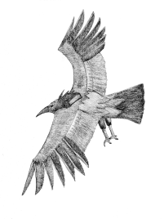
The solution
Redesign the programme to embed employability and report back to me with a plan
The constraints:
Maintain research income
Cost neutral (or thereabouts)
Implementable on reasonable timescale
By Carnby - Own work, CC BY-SA 4.0, https://commons.wikimedia.org/w/index.php?curid=45152282
Notes:
PVC-either as a result of the previous discussion or because the University has decided on an embedded employability approach whatever the Dept thinks… To help here is an invited expert lecture:
Research – can’t just switch staff to teaching
Cost neutral – no new (additional) bought-in teaching;
Implementable: no grand schemes for industrial placements etc

Slide 19
Invited Lecture
Embedding Employability

Slide 20
What is Employability? (HEA, 2013)
• a lifelong process
• applicable to all students (situations, courses, modes of study)
• support for students to develop knowledge, skills, behaviours, attributes and attitudes to enable success in employment and in life
• a university-wide responsibility
• makes the components of employability explicit to students to support their lifelong learning

Slide 21
What Employability is not:
• It is not about replacing academic rigour and standards
• It is not necessarily about adding additional modules into the curriculum
• It is not just about preparing students for employment
• It is not the sole responsibility of the Careers Service
• It is not something that can be quantified by any single measure (Destinations of Leavers from Higher Education (DLHE) survey is a measure of employment not employability.)

Slide 22
Embedding Employability is …
1.Constructive Alignment
Professional
Expert Student
Structured and focussed
Fractured and unformed
End point
Starting point
Learning Community
Them and us
Subject Knowledge and skills
Prior Knowledge and Goals
Assessment
Community

Slide 23

Embedding Employability is …
2. Skills Support
“Learning is the process whereby knowledge is created through the transformation of experience”
Have
an experience
Reflect/
Review
Plan/ Try out/ Test
Model Experiences
(Exemplars)
Transform
Read
Write
Speak
Listen
Discuss
Apply
Generalisations
(What you can usefully
do with knowledge)
Conceptual-ise (Learn)

Slide 24


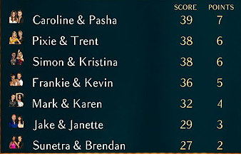



Embedding Employability is …
3. Authentic Assessment
Competency (more or less)
Selection
Progression
Prizes
Evaluation
Notes:
What are we assessing for?

Slide 25
Authentic Assessment - What is it?
(Ashford-Rowe & Brown, Establishing the critical elements that determine authentic assessment, 2014)
Authentic Assessment:
– is challenging
– has performance or product as outcome
– design should ensure transfer of knowledge
– metacognition is a component of authentic assessment
– has a requirement for accuracy
– has formal opportunity for discussion and feedback
– values collaboration

Slide 26
Pseudo Authenticity: An Example
Joe and Sal decide that little Ronny is well-behaved enough to sit at the table with the family for Thanksgiving dinner. They are wrong. Ronny throws a 150 g handful of mashed potatoes horizontally with a speed of 5 m/s. It strikes a 1.2 kg gravy boat that is initially at rest on the frictionless table. If the potatoes stick to the gravy boat, what is the speed of the combined system as it slides down the table towards Grandpa?
Tipler Physics 4th Ed
Notes:
What’s not authentic? – Is it that a child can’t hold 150g of mashed potato in a handful or that a 1.2 kg gravy boat it unreasonably huge? ☺ - who would ever want to know this? It’s no so much authentic as pointless.

Slide 27




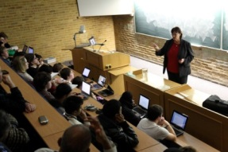

Authentic Assessment – Examples
Conferences with a purpose
Observe a (simulated) variable star and interpret - too much data for each group to carry out the whole project alone. Presentations are required to exchange information.
Presentations in context
Act as an expert witness on a piece of forensic evidence
Reports for an audience
An Insurance Scam?
Insurance company
Advertising standards authority
Book chapter
Research in media
Lecture, Podcasts, Video, Website
Notes:
Transfer of knowledge – accuracy/challenge – product outcome – collaboration

Slide 28
Embedded Employability Examples
Chris Dewdney (Portsmouth) on Employer Engagement
Embedding Employability in a new Physics Degrees
John Mitchel (UCL)on Curriculum Design
An Integrated Engineering Programme
Richard Wilcock, Career Development Service (Leicester)
on University Level Programmes
Maximising Graduate Success

Slide 29
Questions?

Slide 30
Workshop Programme
1. A crisis in the Department of Cryptozoology – PVC University of Erewhomes
2. Embedding Employability: Invited Lecture
3. Initial group discussion on the issues
4. The Employability Matrix
5. Group discussion and feedback
6. Embedded employability in UoL Natural Sciences
-the programme
-the outcomes
-central support
7. Individual/group reflection on application in your own context
8. Workshop evaluation

Slide 31
Employability table (Simplified)
Level→ Scale | Discover (State) | Progress (Explore) | Achieve (Apply)
Individual
Career guidance and management
Confidence, resilience and adaptability
Behaviours, Qualities and Values
Meta cognition (Reflection and articulation)
Specialist technical and transferable skills
Internal Group
Behaviours, Qualities and Values (articulation)
Specialist technical and transferable skills
External
Social/cultural awareness
Enterprise and entrepreneurship
Internationalisation
HEA scales from Jane Artess, Tristram Hooley, Robin Mellors-Bourne, (2016) Employability: a review of the literature 2012-2016, (HEA) (Those in italics have NOT been included in the table)
Confidence, resilience and adaptability
Experience and networks
Attributes and capabilities
Specialist technical and transferable skills
Knowledge and application
Behaviours, qualities and values
Enterprise and entrepreneurship
Career guidance and management
Self, social and cultural awareness
Reflection and articulation.
Concepts and models
Policy-related
Internationalisation
Notes:
Simplified version. Note that this is not just transferable skills (“let’s ask students to do a presentation and that will crack it”)

Slide 32
Achievement→ Scale | Discover (State) | Progress (Explore) | Achieve (Apply)
Individual
Career guidance & management | PDP: Tutor meetings | CV: workshop mock interview Careers fair: alumni | CV submissions Interviews
Confidence, resilience and adaptability | Time management: planned schedule | Time allocation – multiple Complex Schedule Resilience workshop | Open-ended projects
Meta cognition (Reflection & articulation) | Feedback (closed questions) | Feedback (open ended assignments) | Act on feedback
Technical skills
Internal Group
Behaviours, Qualities & Values | Group rules: induction Attendance | Peer review: in-group reports Group roles | Student-staff interaction Peer Review: out-group papers
Transferable skills
External
Social/cultural awareness
Enterprise and entrepreneurship
Internationalisation
Notes:
Derek
Examples: Start from column 3 and work backwards – IN PARTICULAR: Identify opportunities for authentic assessments

Slide 33
Workshop Programme
A crisis in the Department of Cryptozoology – PVC University of Erewhomes
Address by Head of Department of Cryptozoology
3. Embedding Employability: Invited Lecture
4. Initial group discussion on the issues
5. The Employability Matrix
6. Group discussion and feedback
7. Embedded employability in UoL Natural Sciences
-the programme
-central support
-the outcomes
8. Individual/group reflection on application in your own context
9. Workshop evaluation
Notes:
Groups give their proposed solutions for the Crypto Department. Note this can be at module, programme or institutional level, so involves all attendees. I suggest homogeneous groups (careers and admin/ course directors/individual staff), but could mix them up?

Slide 34
Embedded employability in the Natural Sciences Programme at the University of Leicester

Slide 35
Brief overview of the Natural Sciences programme
Evaluation
3. Recognising Skills
Notes:
Kath

Slide 36
Natural Sciences Degree Structure
Core Science Problem-Based Learning (PBL) Modules
Support Modules
Year 1 | Mod 1 | Mod 2 | Mod 3 | Mod 4
Year 2 | Mod 5 | Mod 6 | Mod 7 | Mod 8
Year 3 | Mod 8 | Mod 9 | Mod 10
Year 4 | Mod 11 | Mod 11 | Mod 12 | Mod 12
Year 1 | Maths Skills | Maths Skills | Maths Skills | Maths Skills
Year 2 | Maths | Maths | Maths | Maths
 | Skills | Skills | Skills | Skills
Year 3 | Maths | Maths | Maths
 | Skills |  | Journal | Journal
Practical
Projects
Year 1 | Lab IT | Lab IT | Lab IT | Lab IT
Year 2 | Lab IT | Lab IT | Lab IT | Lab IT
Year 3 | Lab IT | Lab IT
Year 4 | IT | IT
Year 1
Year 2
Year 3 |  |  | Individual Project
Year 4 | Individual Research Project Individual Literature Project
Notes:
Note integrated IT, skills and maths (but not lab!)

Slide 37
Achievement→ Scale | Discover (State) | Progress (Explore) | Achieve (Apply)
Individual
Career guidance & management | PDP: Tutor meetings | CV: workshop mock interview Careers fair: alumni
Confidence, resilience and adaptability | Time management: planned schedule | Time allocation – multiple Complex Schedule Resilience workshop | Open-ended projects
Meta cognition (Reflection & articulation) | Feedback (closed questions) | Feedback (open ended assignments) | Research project JIST Journal
Technical skills | Science Presentation Science Writing Lab reports and analysis Laboratory awareness IT competencies | Presentation/writing to an audience Experimental skills Computer programming (set exercises) | Project reports Computer programming application
Internal Group
Behaviours, Qualities & Values | Group roles: induction Attendance | Peer review: in-group reports Group rules | Personal interactions Refereeing: out-group papers
Transferable skills | Small scale research given materials Short Communication Pairwise discussion | Research Group Roles Presentation Negotiation | Group Reports
External
Social/cultural awareness | In class questions Small group Tutorial | Short presentations Student partnerships | Seminar lead Work experience Networks
Enterprise and entrepreneurship | Student-Staff Committee | Student Committee Blogs | Conference organisation
Internationalisation |  | Joint activities with McMaster | Exchange students
Notes:
This is post-hoc; but PBL with authentic varied assessments virtually guarantees coverage. BUT do the students recognise this?

Slide 38
2. Evaluation
How well does it work?
Notes:
Cheryl

Slide 39
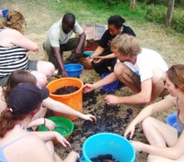
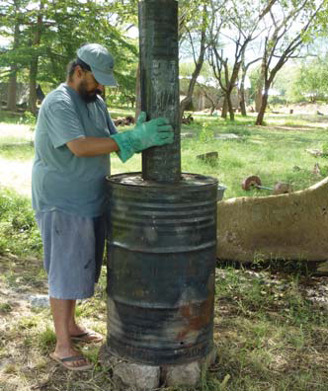
Change in Confidence and Competence
Proficiencies:
  Presentation Skills,
  Engaging with others academically (discussing ideas and problems)
  Professionalism (meeting deadlines, being on time etc.)
Subject knowledge:
  Biology,
  Chemistry,
  Physics,
  Earth Sciences

Slide 40
Changes in confidence, changes in competence
Increase in confidence
  Presentation skills (explicitly taught)- 77.2%
  Engaging with other students (implicit)- 80%
  Professionalism (implicit)- 68.5%
Confidence vs competence map quite closely
similar pattern for presentation skills (explicit)
and professional skills (implicit)
Notes:
Horizontal grid steps are 5 students. Note engaging with others is bunched towards positive change; Physics has greatest negative impact; competence and confidence are least well matched in biology. Note that presentation skills (which is explicitly taught and implicitly practiced) is much like Engaging with others (which is implicit) – very positive effect.

Slide 41
Alumni quotes on skills
Hugo, now grad student at McMaster: “With hindsight, pbl has been 'spot-on’.”
Donna, Finance Manager: “Without my degree I do not believe I would have progressed as far as I have in the short space of time I have been with Norbert Dentressangle. A degree in science does not mean you are ever restricted in pursuing a career in a completely different field.”
Suzanne, IT company: Her current project involves computer coding, getting a tablet product out and monitoring its quality. She says that the key to where she is today is the research nature of the degree
Louise is a research scientist and civil servant: originally shy, Louise says that as a result of the degree she now feels confident at delivering information in front of large crowds. Overall she feels more of a ‘strong’ character in these high pressure working environments.
Antony (Clinical research): “With hindsight, I have realised just how many skills that the [Natural Sciences] course and staff there have instilled in me.”

Slide 42
Brief overview of the programme
Evaluation
Recognising Skills
Notes:
Derek

Slide 43
Supporting students in recognising Skills
Notes:
My name is Anna Graves and I’m the careers adviser linked to the Centre for Interdisciplinary Science. I work with the department to provide careers support as part of the curriculum. I’m going to talk about how we have integrated the careers support into the Natural Sciences degree programme.

Slide 44


Personal Development
Professional development
Identify strengths, development areas and motivations
Reflect on and demonstrate transferable skills developed through the course and extracurricular experience
Record skills and experience in a CV
Relate strengths, transferable skills and motivations to a chosen opportunity and articulate them in a tailored application and interview
Prepare for all stages of the assessment and selection process
Evaluate your assessment and selection process
Notes:
Three good reasons for undertaking a significant experience alongside your studies
Develop your skills and confidence
Enhance your academic performance
Improve your prospects of highly skilled work or further study
Start by completing the Leicester Award which will help you to: (column 1)
Move on to the Leicester Award Gold in order to: (column 2)

Slide 45
Achievement→ Scale | Discover (State) | Progress (Explore) | Achieve (Apply)
Individual
Career guidance & management | PDP: Tutor meetings | CV: workshop; mock interview Careers fair: alumni
Confidence, resilience and adaptability Resilience, adaptability and drive Planning and organising | Time management: planned schedule | Time allocation – multiple Complex Schedule Resilience workshop | Open-ended projects
Meta cognition (Reflection & articulation) Learning, improving and achieving | Feedback (closed questions) | Feedback (open ended assignments) | Research project JIST Journal
Technical skills Digital Skills | Science Presentation Science Writing Lab reports and analysis Laboratory awareness IT competencies | Presentation/writing to an audience Experimental skills Computer programming (set exercises) | Project reports Computer programming application
Internal Group
Behaviours, Qualities & Values Leadership and supervising Teamwork | Group roles: induction Attendance | Peer review: in-group reports Group rules | Personal interactions Refereeing: out-group papers
Transferable skills Communicating; Researching and Analysing Problem solving and decision making | Small scale research given materials Short Communication Pairwise discussion | Research Group Roles Presentation Negotiation | Group Reports
External
Social/cultural awareness | In class questions Small group Tutorial | Short presentations Student partnerships | Seminar lead Work experience Networks
Enterprise and entrepreneurship | Student-Staff Committee | Student Committee Blogs | Conference organisation
Internationalisation |  | Joint activities with McMaster | Exchange students
Student facing descriptions
Notes:
These are the skills as defined by UoL CDS psychologist which students are asked to think about mapped to the matrix

Slide 46
Following completion of your significant experience: Identify and evaluate at least two skills or strengths you have developed, and how these were utilised during your experience Effectively evidence your experience within a Curriculum Vitae (CV) Evaluate your significant experience and create an action plan for your next steps | Project-based learning An enterprise challenge Work-based placement (e.g. Year In Industry) Professional volunteering (e.g. in a school) Study Abroad
Further support with your personal and career development
Talk to your peer mentor or personal tutor
Join a sports club or student society
Register as a volunteer
Contact your department’s Study Abroad co-ordinator
Find some part-time work (Unitemps)
Attend the annual Festival of Careers
Make an appointment with the Career Development Service:
  Advice on your career options and how to gain relevant experience; Support with applications; Mock Interviews; Business Coaching

Slide 47
Summary
Students recognise the importance of professional skills
They do not always recognise the value of the way the programme delivers these (not a single free form comment was about skills)
Graduates judge the effectiveness of the programme more positively
Notes:
But note selection effect with graduates – these are the ones who have kept in touch.

Slide 48
Workshop Programme
1. A crisis in the Department of Cryptozoology – PVC University of Erewhomes
2. Embedding Employability: Invited Lecture
3. Initial group discussion on the issues
4. The Employability Matrix
5. Group discussion and feedback
6. Embedded employability in UoL Natural Sciences
-the programme
-central support
-the outcomes
7. Individual/group reflection on application in your own context
8. Workshop evaluation
Notes:
Kath
Division of labour for two leaders, A and B:
This introduction: B (or C): 1. A; 2. B; 3. A and B facilitate; 4. B; 5. A 6. A and B facilitate 7. A (or C)
I will begin by explaining the problems in our Department of Cryptozoology which will provide a context for your discussion of employability. To help with the discussion we’ll have a lecture from my colleague which will include some recorded contributions from experts who cannot be with us today. We’ll ask you to feed back very briefly on your discussions. We’ll then look at a specific example of how employability is embedded in the Natural Sciences programme at Leicester. And we’ll ask you to reflect on what you might take away from this workshop for your own context. While much of the initial focus will be on curriculum planning, the important point is that employability can be embedded from the top down or the bottom up – you can start from a blank sheet and a master plan or from a step-by-step approach at module or sub-module level. Finally we’ll ask for your feedback.

Slide 49
Workshop Programme
1. A crisis in the Department of Cryptozoology – PVC University of Erewhomes
2. Embedding Employability: Invited Lecture
3. Initial group discussion on the issues
4. The Employability Matrix
5. Group discussion and feedback
6. Embedded employability in UoL Natural Sciences
-the programme
-central support
-the outcomes
7. Individual/group reflection on application in your own context
8. Workshop evaluation
Notes:
Kath
Division of labour for two leaders, A and B:
This introduction: B (or C): 1. A; 2. B; 3. A and B facilitate; 4. B; 5. A 6. A and B facilitate 7. A (or C)
I will begin by explaining the problems in our Department of Cryptozoology which will provide a context for your discussion of employability. To help with the discussion we’ll have a lecture from my colleague which will include some recorded contributions from experts who cannot be with us today. We’ll ask you to feed back very briefly on your discussions. We’ll then look at a specific example of how employability is embedded in the Natural Sciences programme at Leicester. And we’ll ask you to reflect on what you might take away from this workshop for your own context. While much of the initial focus will be on curriculum planning, the important point is that employability can be embedded from the top down or the bottom up – you can start from a blank sheet and a master plan or from a step-by-step approach at module or sub-module level. Finally we’ll ask for your feedback.

Slide 50
The CATE Team
Sarah Gretton, Cheryl Hurkett, Dylan Williams, Kath Clark, Paul Abel, Derek Raine
sng8@le.ac.uk jdr@le.ac.uk

Slide 51
EXTRAS

Slide 52
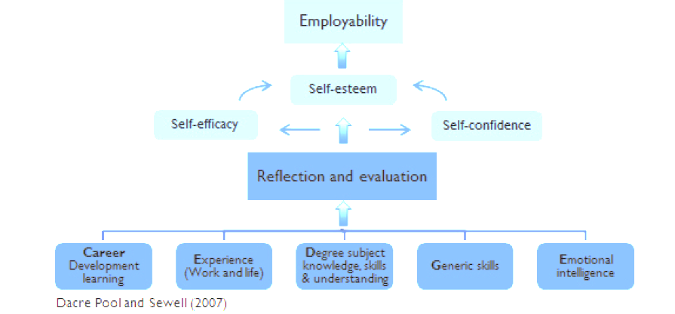
The CareerEDGE model - how the whole university experience contributes to a student’s employability
Cole, D. and Tibby, M. (2013) Defining and developing your approach to employability York, The Higher Education Academy: 7
Notes:
You might be familiar with the CareerEDGE model of employability, which demonstrates how the whole university experience contributes to a student’s employability. We’ve heard how the students are gaining degree subject knowledge and skills, as well as developing generic skills. My role then is to help the students recognise their generic skills and put their learning into context with career development learning. I run a series of sessions with the students to help them reflect and evaluate what they have done, in the hope of building self-awareness and confidence so that they are able to compete in the recruitment process.

Slide 53
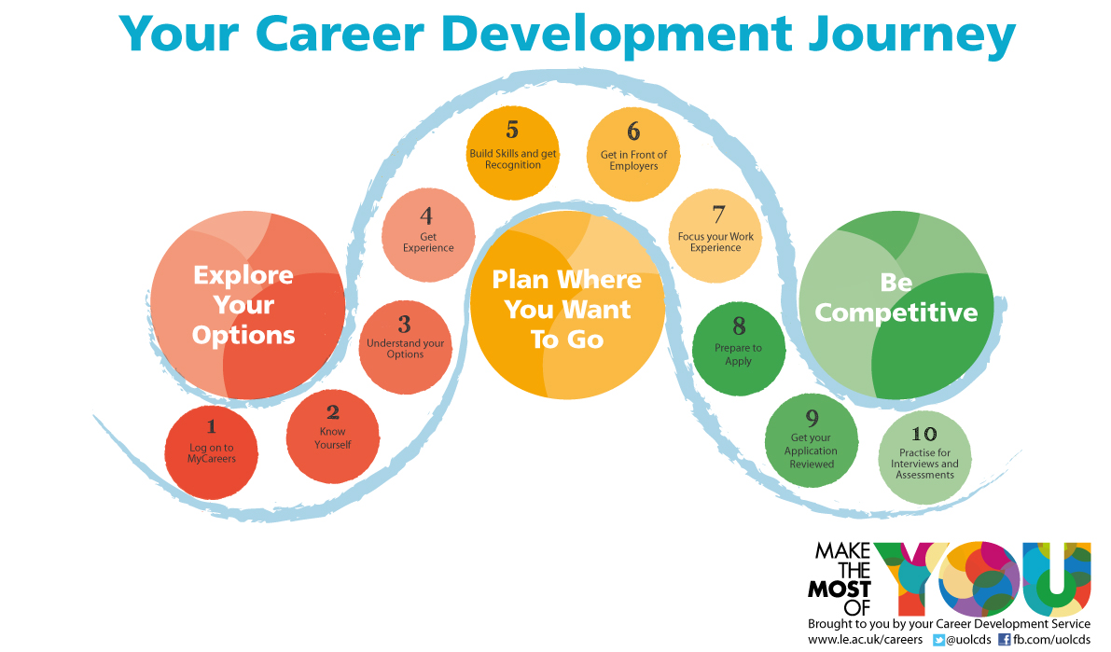
Notes:
At Leicester we achieve this via our Career Development Journey. The idea is that a student can progress through each stage of this journey in order to get wherever they want to be when they graduate (e.g. a graduate job or further study). The student can tailor their journey to suit their own career because there are a range of activities they can do at each stage. In the first year, we introduce the students to various career paths with their discipline, encourage them to undertake some reflection on their personal values and motivations and begin to gain some experience by offering them a taster experience and raising awareness of the range of extracurricular activities they can get involved in. This contributes to their career development learning. We encourage them to then start doing something to build their generic skills through a range of activities. We then encourage students to gain experience, before finally being ready to compete in the recruitment process. Along this journey, the majority of these activities are followed up with some reflection.
In the case of Natural Sciences, aside from the aspects that the students’ must complete individually, the rest of this journey is embedded into the curriculum. In particular at stage 5, the students are building wide range of skills through problem-based learning.

Slide 54
‘Articulating your skills’ sessions
Take place in year 2
Developed in collaboration between CDS and Natural Sciences department
Focus on how to articulate the skills from a Natural Sciences degree on an application form, CV and covering letter
Notes:
Although the students are developing key transferable skills throughout their course, the risk of embedding them so seamlessly into the course is that they just see their skills as part of their degree and don’t recognise the value of them when it comes to applying for jobs. We therefore collaborated to put on sessions for second year students to highlight the importance of the skills gained through their degree and focus on how to articulate these skills in the job application process.

Slide 55
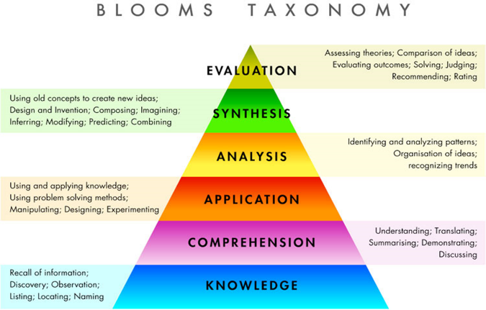
Bloom’s Taxonomy
Evaluate the effectiveness of your own CV against the job criteria
Compose an effective, tailored CV or answer to an application question
Analyse the employer’s requirements to explain why the skills gained from a Natural Sciences degree are of benefit to an employer
Use the Transferable Skills Framework to come up with examples of skills
Discuss the different sections you might use on a CV and summarise what might be included
Recall models for structuring an application e.g. STARS
Krathwohl, D. R. 2002. "A Revision of Bloom's Taxonomy: An Overview." Theory into Practice 41(4):6.
Notes:
In the career development service here at Leicester, we ensure that our learning activities are underpinned by sound teaching and learning theories, and have designed our provision in line with Bloom’s Taxonomy of Learning. You might have used Bloom before in designing learning outcomes. The taxonomy focusses on the level of learning we want our students to achieve, and the words we use to explain this to students. Here I will give some examples of how these different levels of learning are reflected in the different activities in the sessions I have discussed so far.
More broadly with career development, we could use this to help a student plan their future career. ‘Remember’ might entail listing different career options pursued by graduates in their discipline. ‘Understand’ might include some discussion and self-reflection on personal values. ‘Analyze’ might entail examining some potential career option in relation to those personal values, which will lead to the higher levels of learning where a student is able to decide on a career path and assess their suitability for it.
It is useful to view career development as a learning process and there are many theories to support this. The point here is that career development is not so different from any other learning process we might undertake. Our approach ensures that students are equipped with a wide range of subject knowledge along with the key skills employers look for, as well as the ability to demonstrate their skills and suitability for a role in the recruitment process. This then enables them to pursue a whole range of different career path (both scientific and other), in line with our mission to provide students with career management skills for life, not just to secure a graduate job.

Slide 56
Articulating your skills in applications
With reference to Transferable Skills Framework, come up with an example of each skill from their degree
Create an ‘elevator pitch’ to explain to employer why they should hire them as a Natural Sciences graduate
Critique example application forms
Come up with answers to competency questions using the examples they created at the beginning
Notes:
These are some of the teaching and learning activities in the articulating skills in applications session

Slide 57
Articulating skills in CVs
Act as the careers adviser to offer advice on a mock CV devised from typical mistakes made by Natural Sciences students
Act as a recruiter, reviewing two CVs in relation to a typical job spec and decide who to interview
Learn about Academic CVs from a PhD student in Natural Sciences
Critique own CVs against a checklist with advice from CDS and department.
Given an example CV adapted from good examples from anonymised natural sciences graduates
Notes:
These are some of the teaching and learning activities in the articulating your skills in CVs session.
The collaboration between CDS and the department in putting these sessions together has meant that we have been able to create subject-specific resources and really tailored sessions which have much more relevance to the students. Having such specific resources, examples and knowledge of the course means that we are able to create activities that enable students to reach a higher level of learning, rather than just having a generic session on what to include on a CV.
This has been helped by the fact that I have been invited to departmental contributor’s seminars, sent departmental brochures and had regular discussions with Sarah about developments in the employability provision. At different universities you might have a different model of careers provision, but the more closely you can work with your careers service, the more seamless and relevant your employability provision will seem from the student perspective.

